Slide 1
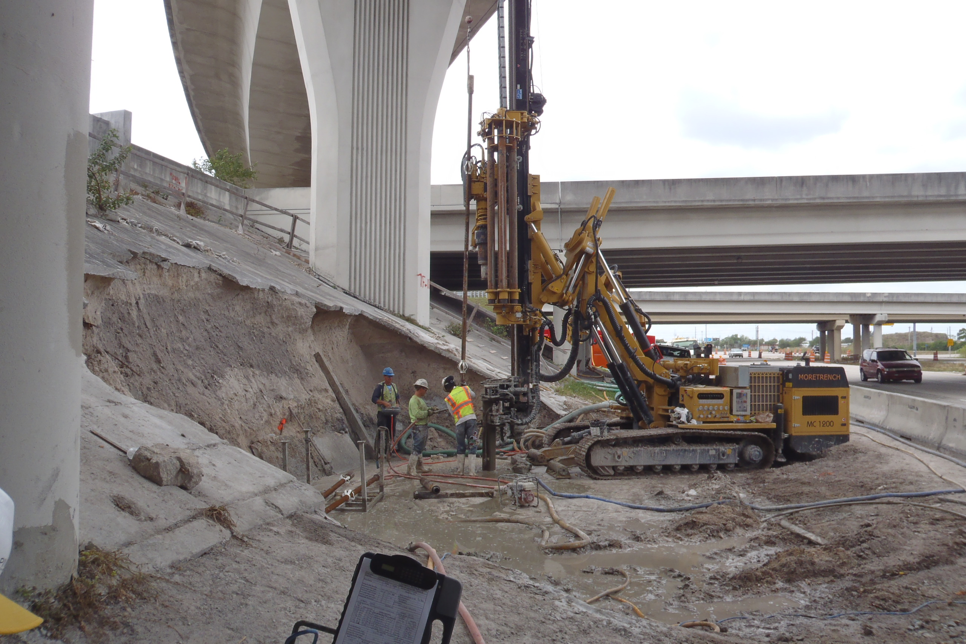

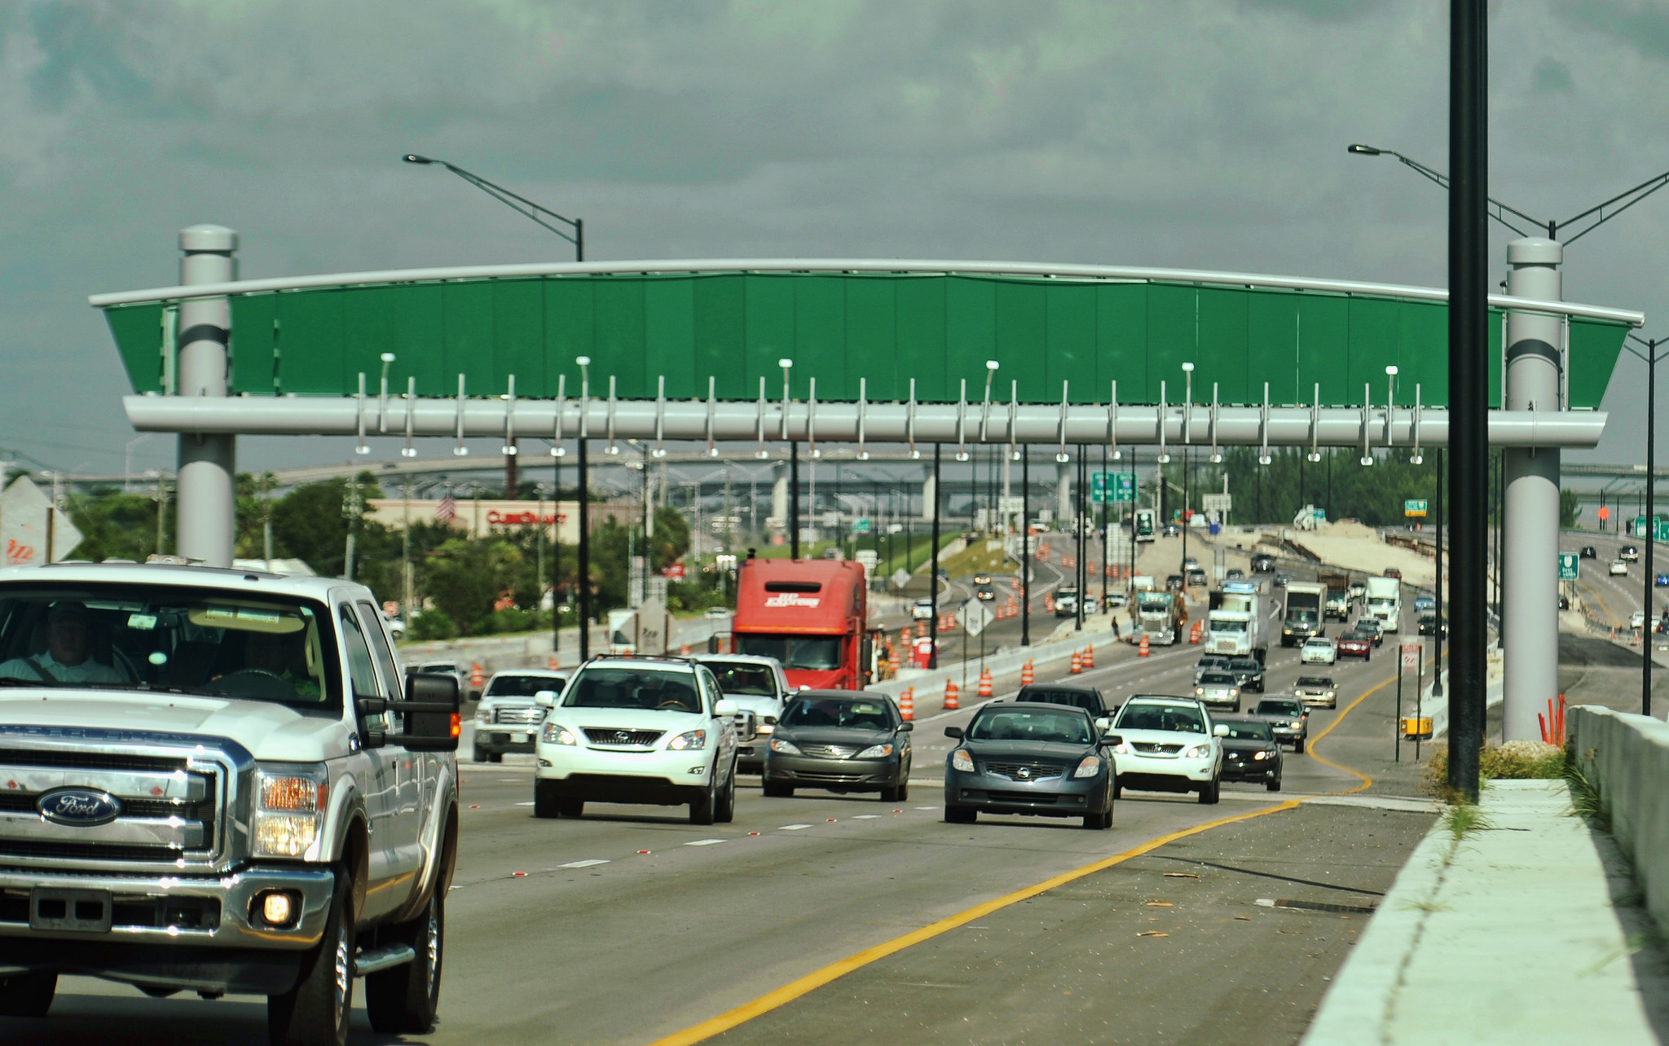
Design and Construction Aspects of Micropiles Used for I-595 Corridor Improvement Project Bridges
Michael B. Woodward, P.E.
Stephanie A. Setser, P.E.
STGEC 2016
November 9, 2016

Slide 2
Background

Slide 3
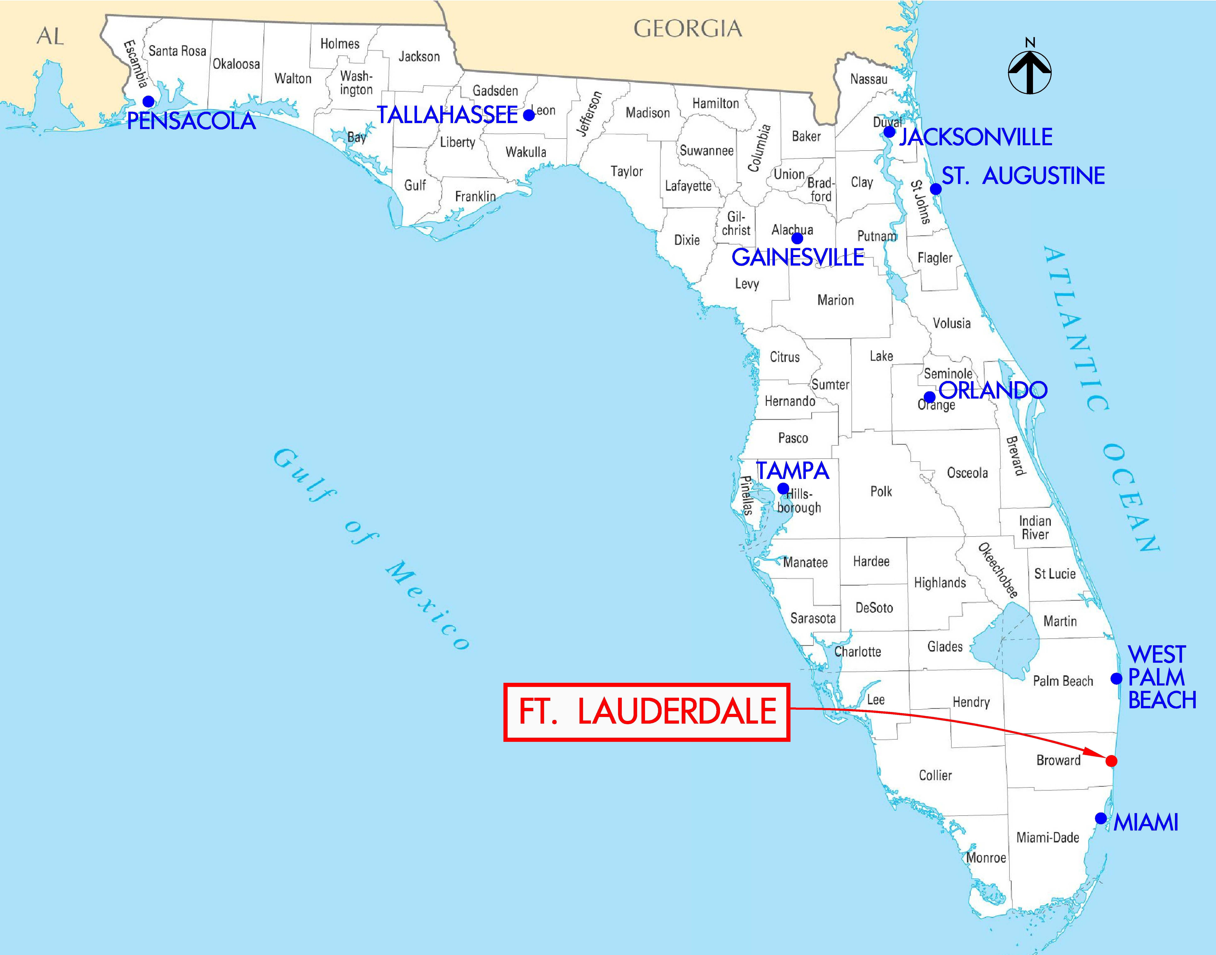
Project location
http://mapsof.net/florida/florida-county-map

Slide 4
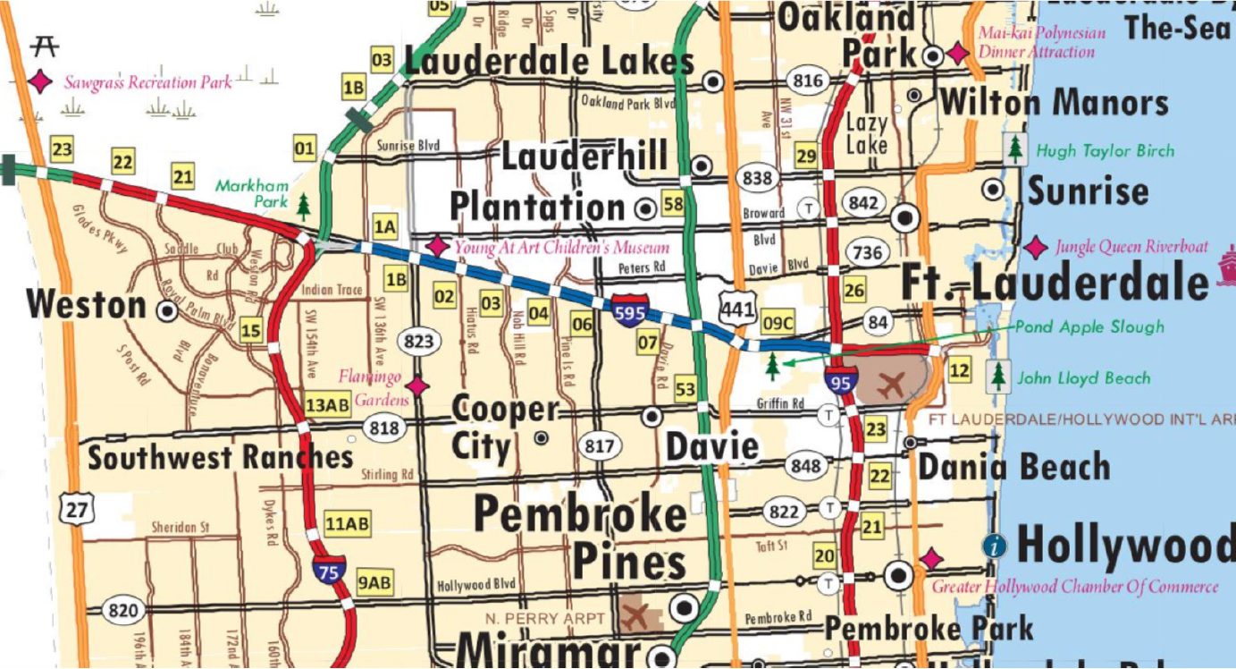
Project location
  Project limits: from I-75 to west of I-95 (10.5 miles)
http://www.dot.state.fl.us/surveyingandmapping/FloridaStateMap.shtm

Slide 5
Background
The I-595 Corridor Improvement Project was the first Public-Private Partnership (P3) for a transportation project in the State of Florida
Design, build, finance, operate, and maintain
$1.2B for design and construction
Partnership between FDOT and private concessionaire (I-595 Express, LLC)
I-595 Express, LLC is a partnership between ACS Infrastructure Development and TIAA-CREF

Slide 6
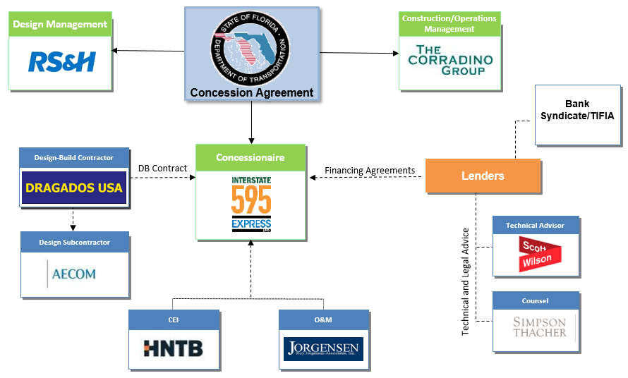
Team organization
http://www.fhwa.dot.gov/

Slide 7
Project Overview
Reconstructed and resurfaced the existing I-595 mainline
Added auxiliary lanes (including associated improvements to frontage roads and ramps)
Three reversible express lanes located in the I-595 median
Total of 62 bridges (widening of existing bridges and construction of new bridges) and associated MSE retaining walls
Project began in 2009; completed in 2014

Slide 8
Geotechnical services
MACTEC Engineering and Consulting, Inc. (now known as Amec Foster Wheeler) provided geotechnical services to AECOM
AECOM used multiple offices in the U.S. and Canada to perform design services
Geotechnical services managed by Amec Foster Wheeler’s Miami office

Slide 9
Geotechnical services
Four other Amec Foster Wheeler offices worked concurrently on different aspects of the project
Approximately 71,000 l.f. of drilling (SPT, auger borings)
18 full-time engineers engaged at peak of design support effort
171 individual reports prepared for design effort

Slide 10
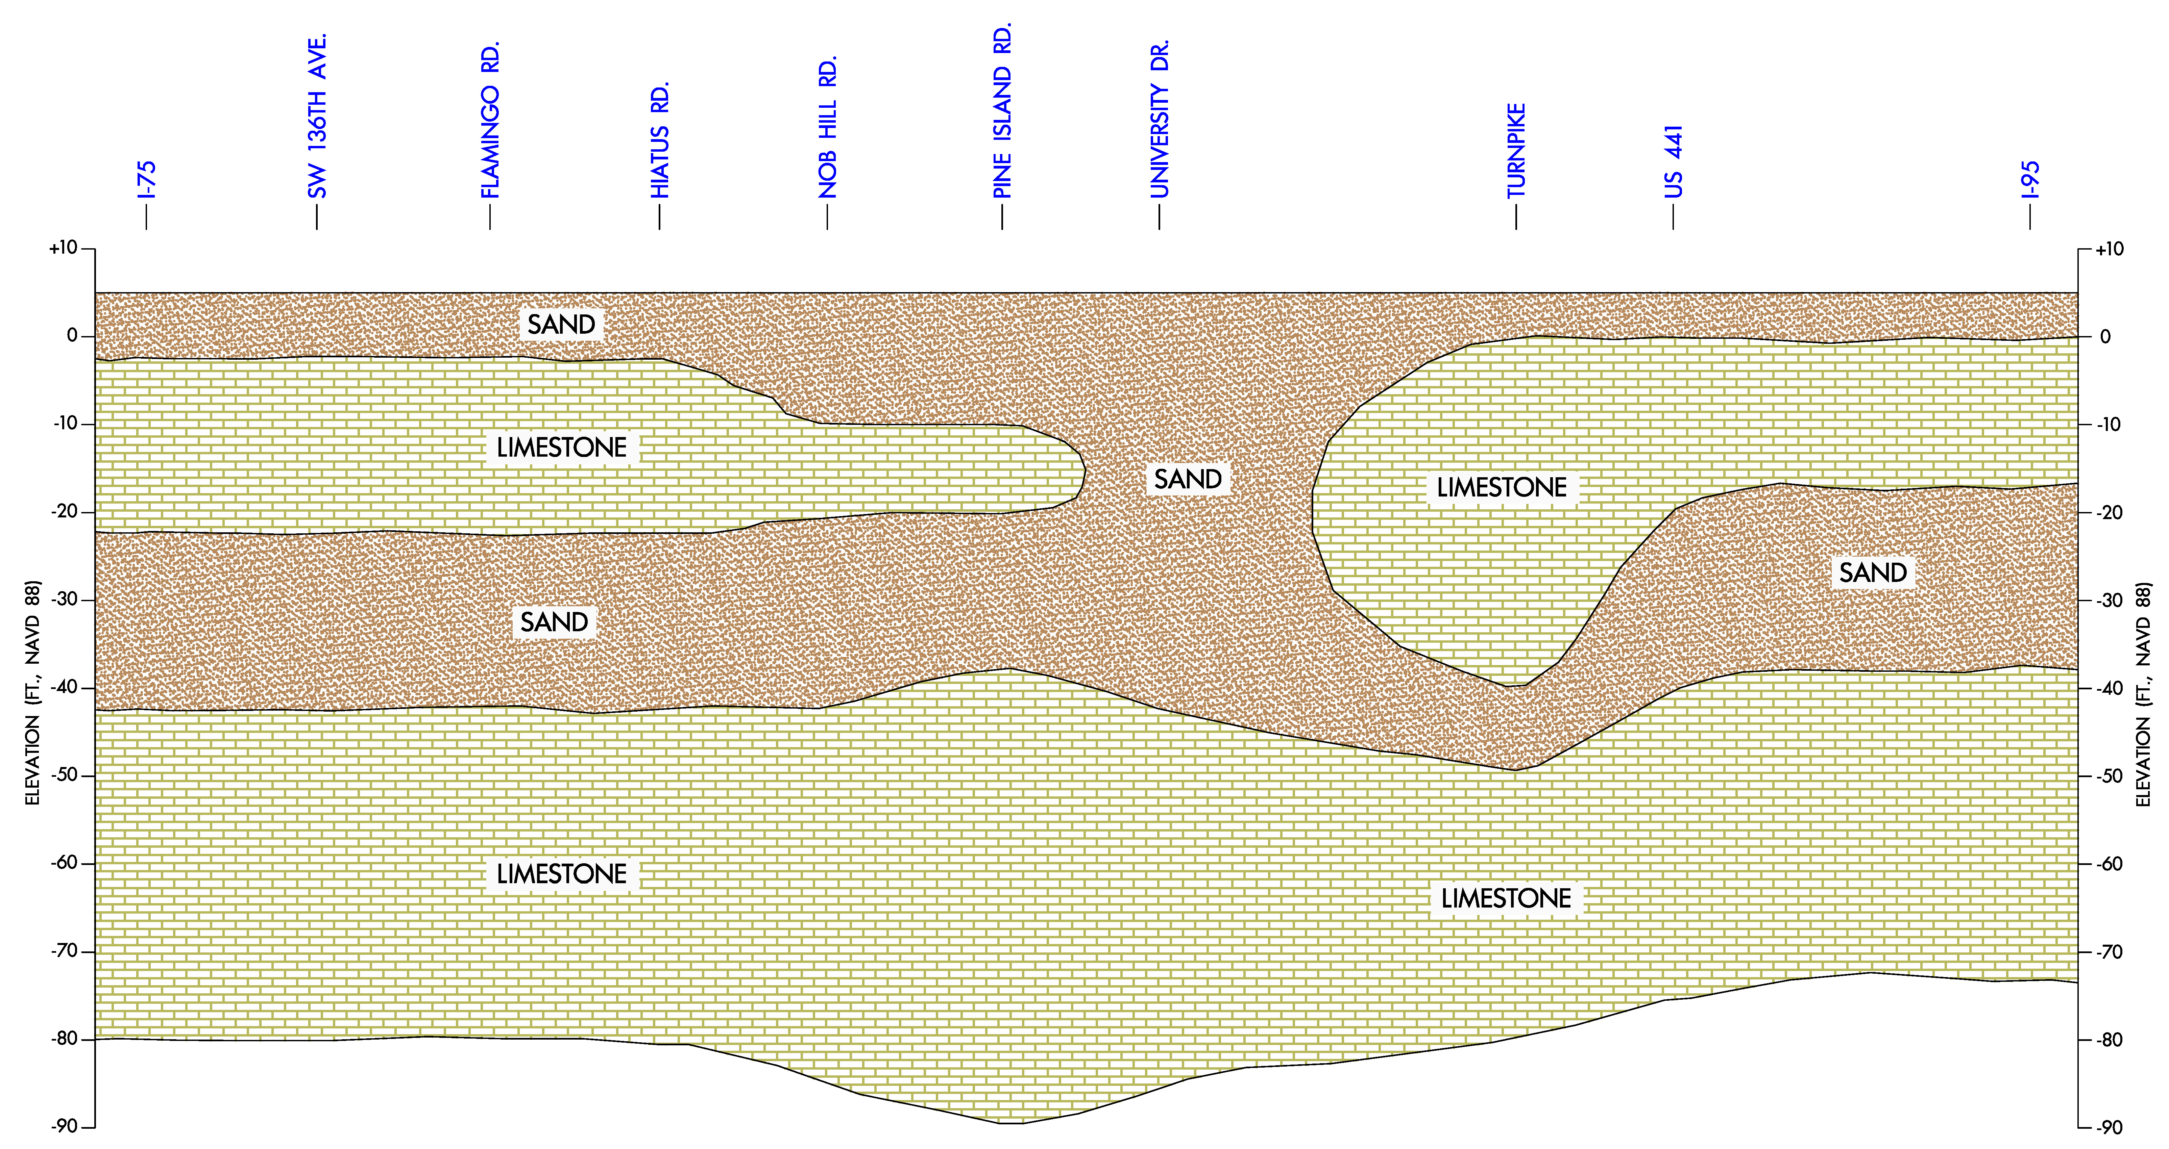
Geology

Slide 11
Foundations
Approximately 2,100 driven piles were installed
  Primarily 18” and 24” prestressed concrete piles
  Minor amount of steel pipe piles
  Average length: 70 feet
Approximately 300 drilled shafts for miscellaneous structures
Approximately 400 foundation certification reports prepared during construction

Slide 12
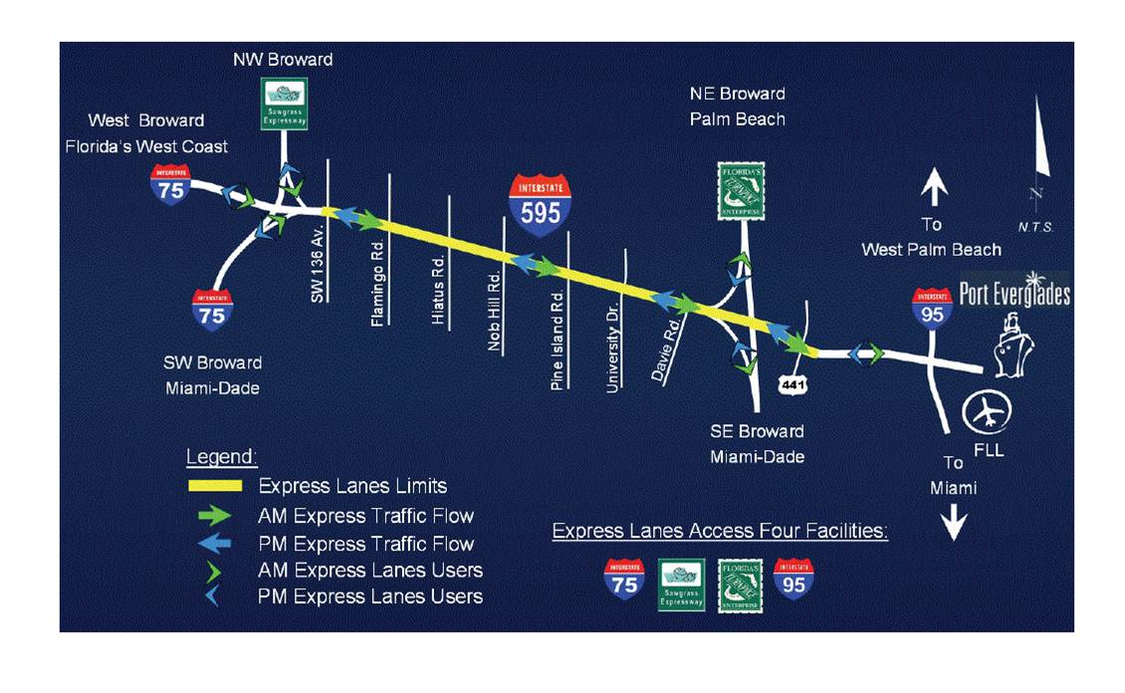
Locations where micropiles were used
Bridge No. 860390 Location
Bridge No. 860418 Location
https://www.transportation.gov/tifia/financed-projects/i-595-corridor-roadway-improvements

Slide 13
Bridge No. 860390
Micropiles used at two pier locations

Slide 14
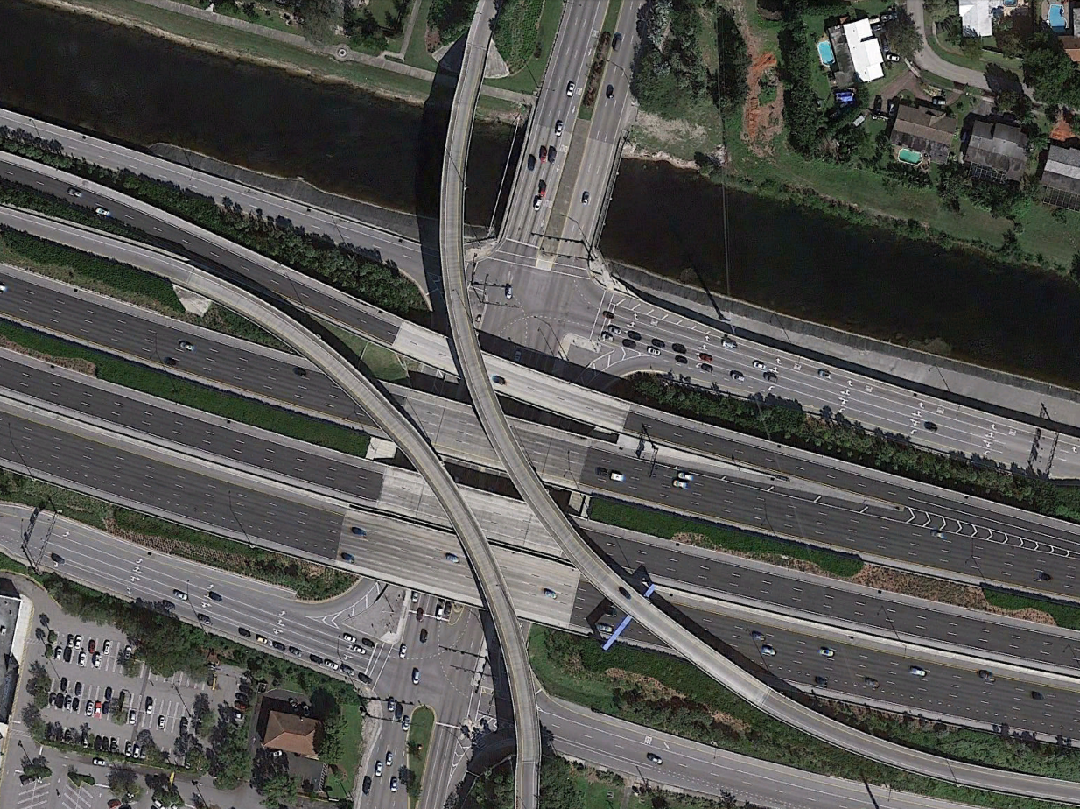
Bridge No. 860390 (2016)
Five-span, single-lane flyover ramp transports SB University Drive onto EB SR 84
Original design called for demolishing and replacing the flyover
Flyover salvaged, but needed to be raised 18” to allow for incorporation into final design of interchange
Bridge No. 860390
Google Earth

Slide 15
Bridge No. 860390
Piers 4 and 5A
Pier 4 (existing) needed to be strengthened for the jacking operation
Pier 5A was a temporary pier needed only for the jacking operation
Pier 4
Pier 5A
Google Earth

Slide 16
Pier 4
Original pier supported by 24-inch square prestressed concrete piles
Perimeter piles are battered
Design for the lift called for the installation of 18-inch diameter, closed-ended steel pipe piles to be driven on each side of the pile cap, and incorporated into a new integral pile cap
Low overhead conditions (approximately 45 feet)
Splices necessary to facilitate pipe pile installation
Required preforming to ensure piles fully penetrate hard zone above the minimum tip elevation

Slide 17
Pier 4 integral cap

Slide 18
Pier 5A (temporary)
Utilized as a jacking platform to raise the flyover
Low overhead conditions (approximately 19 feet)
Originally designed for 18-inch diameter, closed-ended steel pipe piles
Splices necessary to facilitate their installation
Required preforming to ensure piles fully penetrate hard zone above the minimum tip elevation
At one point, helical anchors were also considered

Slide 19
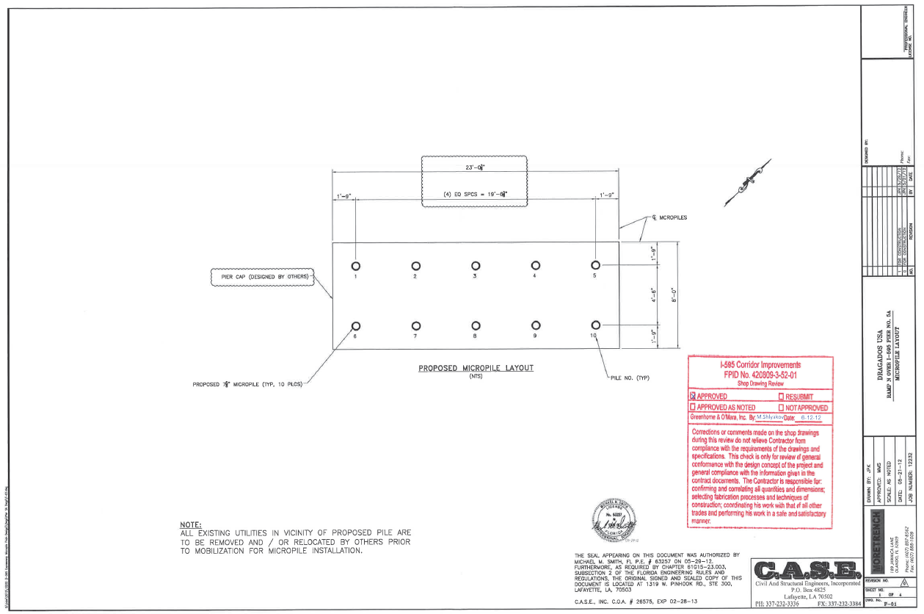
Pier 5A (temporary) foundation layout

Slide 20
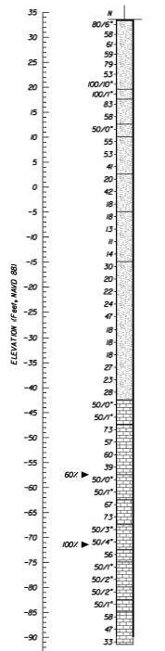
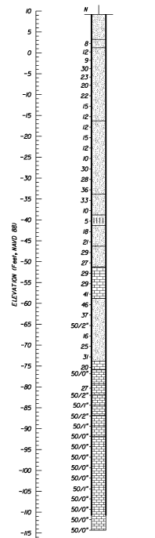
Subsurface conditions
Pier 5A
Pier 4
6’-29’ fill (sand, limerock)
Loose to dense sand (N=5 to >100 bpf) overlying weakly to well-cemented limestone (N=10 to >100 bpf
Fill

Slide 21
Foundation selection and design
Ultimately, micropiles were selected to support Piers 4 and 5A
Design required 10 micropiles to be installed at each pier footing location
Since these piles were installed for the jacking operations only, LRFD design methodology was not required
ASD was used

Slide 22
Micropile design
Micropile design for these two piers performed by Civil and Structural Engineers, Incorporated (C.A.S.E.) for Moretrench Environmental Services, LLC
Universal Engineering Sciences provided geotechnical support for Moretrench
Multiple design iterations occurred – loads changed several times throughout the process (even after the load test)
Design calculations reviewed by Amec Foster Wheeler

Slide 23
Micropile design loads
Bridge No. 860390
Lateral load (Pier 5A): 1.9 tons per pile
7.625” O.D. casing
8” nominal bond zone diameter assumed (d_{b})
Type C method of grouting assumed
Pier No. | Design Pile Load (tons)
4 | 99
5A | 37

Slide 24
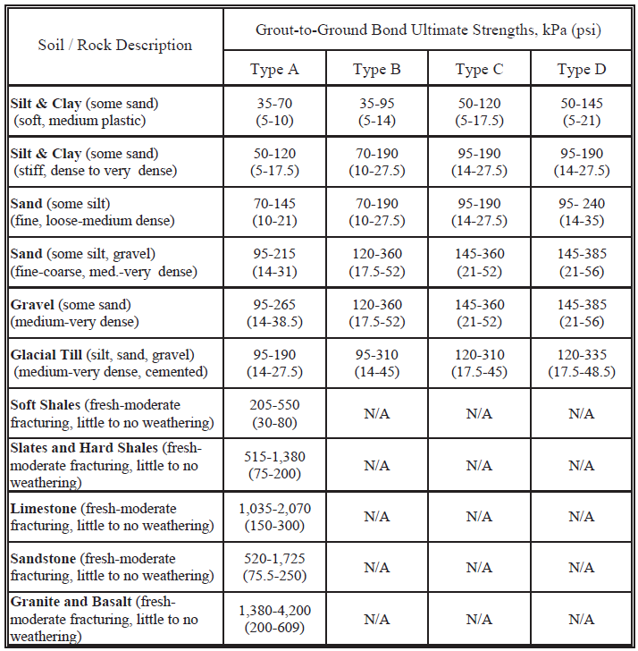
Typical α_{bond} (grout-to-ground bond values)
Type A: Gravity grout only
Type B: Pressure grouted through casing during withdrawal
Type C: Primary grout placed under gravity head, then one phase of secondary “global” pressure grouting
Type D: Primary grout placed under gravity head, then one or more phases of secondary “global pressure grouting
Reference:, Micropile Design & Construction, Table 5-3, FHWA NHI-05-039, December 2005

Slide 25
Typical α_{bond} (grout-to-ground bond values)
Reference:, Micropile Design & Construction, Table 5-3, FHWA NHI-05-039, December 2005
Type C construction method planned
Soil type selected was most similar to subsurface profile encountered by borings
Selected α_{bond} = 40 psi for design calculations

Slide 26
Micropile design assumptions
Assumed all capacity derived in skin friction
Using F.S. = 2.5, calculated bond length, L_{b} = 41’
Selected L_{b} = 55’ (conservative)
Data from test pile at Pier 4 to be used for production piles at both piers
Assumed production piles would be installed in the same fashion as the test pile (same grout pressure, same bond length below casing)

Slide 27
Verification load testing (general)
Verify installation methods capable of achieving the specified grout-to-ground bond capacity with a specified factor of safety
Conducted on non-production, “sacrificial” micropiles prior to construction of production piles
May or may not test micropile to failure
Rigorous multiple-cycle test with the test load progressively increased during each loading cycle until final specified maximum test load is reached

Slide 28
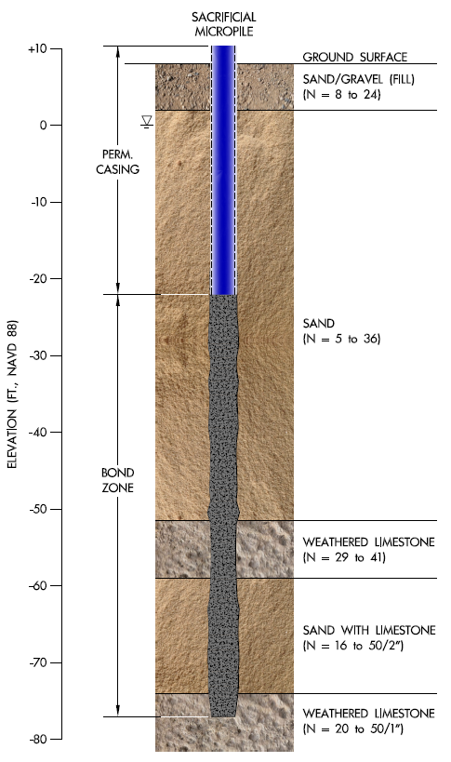
Verification load test pile at Pier 4
Test pile installed with a maximum applied grout pressure of 50 psi
The test micropile was loaded statically in compression
ASTM D1143, Standard Test Methods for Deep Foundations Under Static Axial Compressive Load (Quick Method)

Slide 29
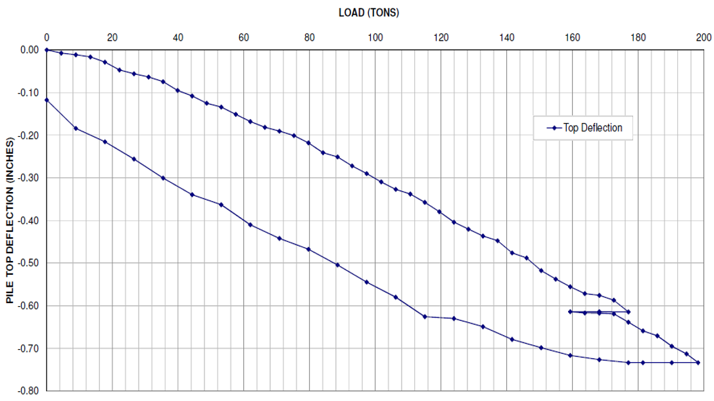
Pier 4 verification load test results

Slide 30
Verification load test summary
The test pile was loaded to 199 tons (approx. 2 x design load)
Downward deflection of approximately 0.3” at the design load (99 tons) and 0.75” at 199 tons
After unloading, the test pile had a permanent settlement of 0.12”
Test pile was not loaded to failure so the ultimate bond strength, α_{bond}, could not be determined
The load test was observed and documented by Amec Foster Wheeler personnel

Slide 31
Pier 4 micropile installation
Over half of the production piles were installed with bond lengths <55’ (51’ to 54’)
Grout pressures of 6 to 30 psi were indicated during installation of three production piles
Grout pressure gauge was later discovered to have malfunctioned
Goal was to confirm that these production piles achieved the required design capacity
F.S. ≥ 2 required

Slide 32
Pier 4 micropile installation
Amec Foster Wheeler personnel did not observe the micropile installations
Micropile installation records prepared by Moretrench personnel
Amec Foster Wheeler was responsible for providing Foundation Certification Packages for both piers

Slide 33
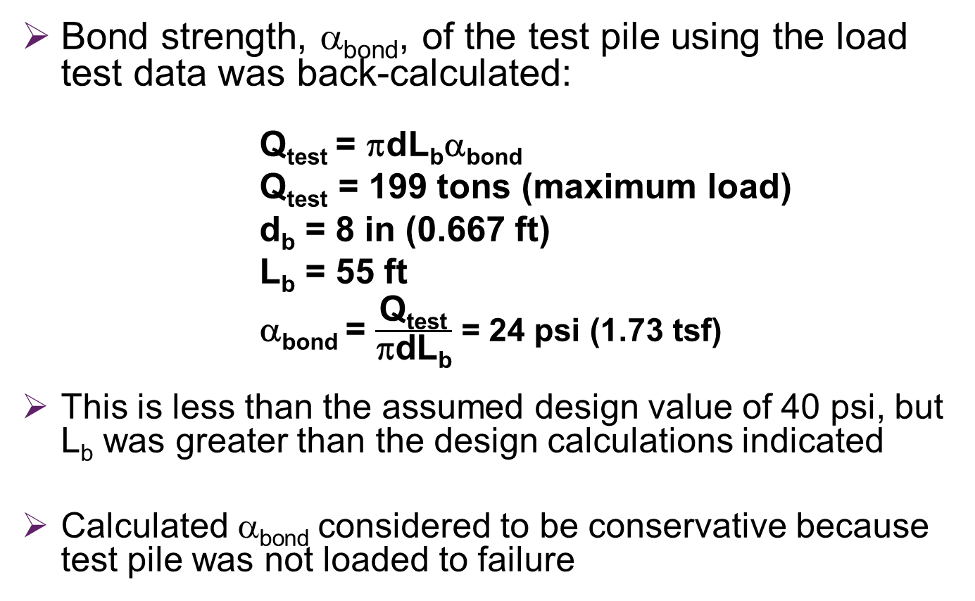
Pier 4 micropile installation issues
Shorter piles
Bond strength, α_{bond}, of the test pile using the load test data was back-calculated:
        Q_{test} = πdL_{b}α_{bond}
Q_{test} = 199 tons (maximum load)
d_{b} = 8 in (0.667 ft)
L_{b} = 55 ft
α_{bond} = $\frac{\text{Q}\text{test}}{\text{p}\text{dL}\text{b}}$ = 24 psi (1.73 tsf)
This is less than the assumed design value of 40 psi, but L_{b} was greater than the design calculations indicated
Calculated α_{bond} considered to be conservative because test pile was not loaded to failure

Slide 34
Pier 4 micropile installation issues
Shorter piles
The capacity of the shorter piles, Q_{short}, was calculated based on actual L_{b} and back-calculated α_{bond}:
Q_{short} = πdL_{b}α_{bond}
The factor of safety was determined by comparing the calculated capacity to the design load
Lowest calculated F.S. = 1.9
Actual factor of safety considered to be higher, and could have been proven if the test pile had been loaded to failure
Conclusion: Shorter piles considered to be acceptable to support the required design loads

Slide 35
Pier 4 micropile installation issues
Lower grout pressures
Grout pressures varied from 6 to 30 psi as indicated by malfunctioning pressure gauge
Although pump appeared to be functioning properly, grout assumed to have been gravity fed (Type A), not pumped under pressure, for conservatism
Pile capacity calculations revised
Diameter of bond zone assumed to not exceed 7.625” O.D. casing
Calculations included revising the α_{bond} to account for Type A grout method

Slide 36
Pier 4 micropile installation issues
Lower grout pressures
Recalculated the pile capacities average α_{bond} value for Type A grouting (22.5 psi) and d_{bond} = 7.625”
Calculated F.S. = 2
Conclusion: lower grout pressure piles considered to be acceptable to support the required design loads
Reference:, Micropile Design & Construction, Table 5-3, FHWA NHI-05-039, December 2005

Slide 37
Bridge No. 860418
Micropiles used at three bent/pier locations

Slide 38
Bridge No. 860418
Carries I-595 EB Over SR 7 (US 441)
Two flyover ramps above Bridge No. 860418:
  Bridge No. 860476 (NB US 441 to WB I-595)
  Bridge No. 860477 (I-595 EB to US 441 NB)

Slide 39
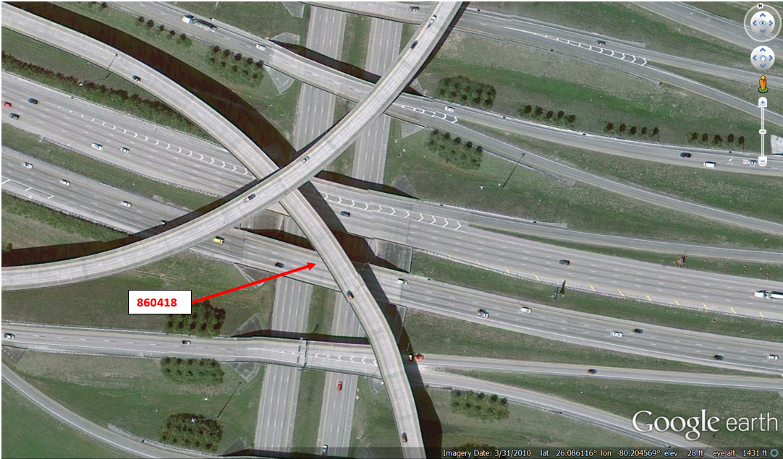
Bridge No. 860418 (2010)

Slide 40
Bridge No. 860418
283’ long
Four spans
Originally three lanes with emergency lanes on each side (56’ wide)
Widened on each side to accommodate six travel lanes, a tapered exit lane, and one (outside) emergency lane (110’ to 120’ wide)

Slide 41
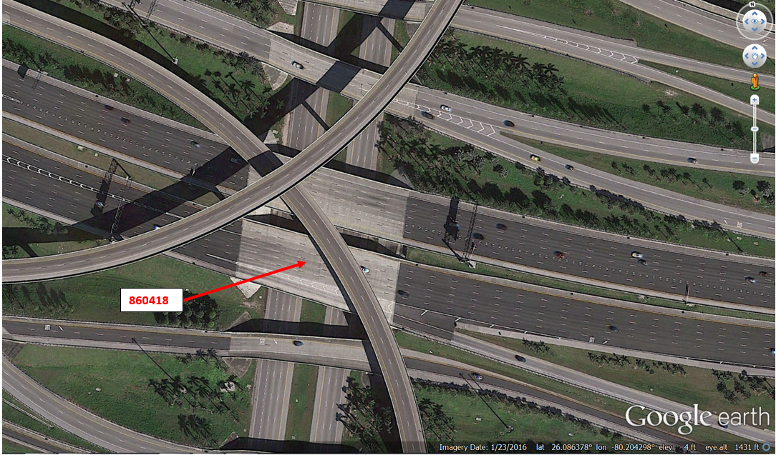
Bridge No. 860418 (2016)

Slide 42
Bridge No. 860418
Existing bridge bents/piers supported by 18” square prestressed concrete (PSC) piles
    Plumb
    Battered
Original design for widening:
    End bents: 18” square PSC piles
    Intermediate piers: 24” square PSC piles

Slide 43
Low overhead conditions
Bridge No. 860418
Bent/Pier No. | Overhead Clearance (ft)
End Bent 1 North | 40
Pier 3 North | 35
Pier 4 South | 35

Slide 44
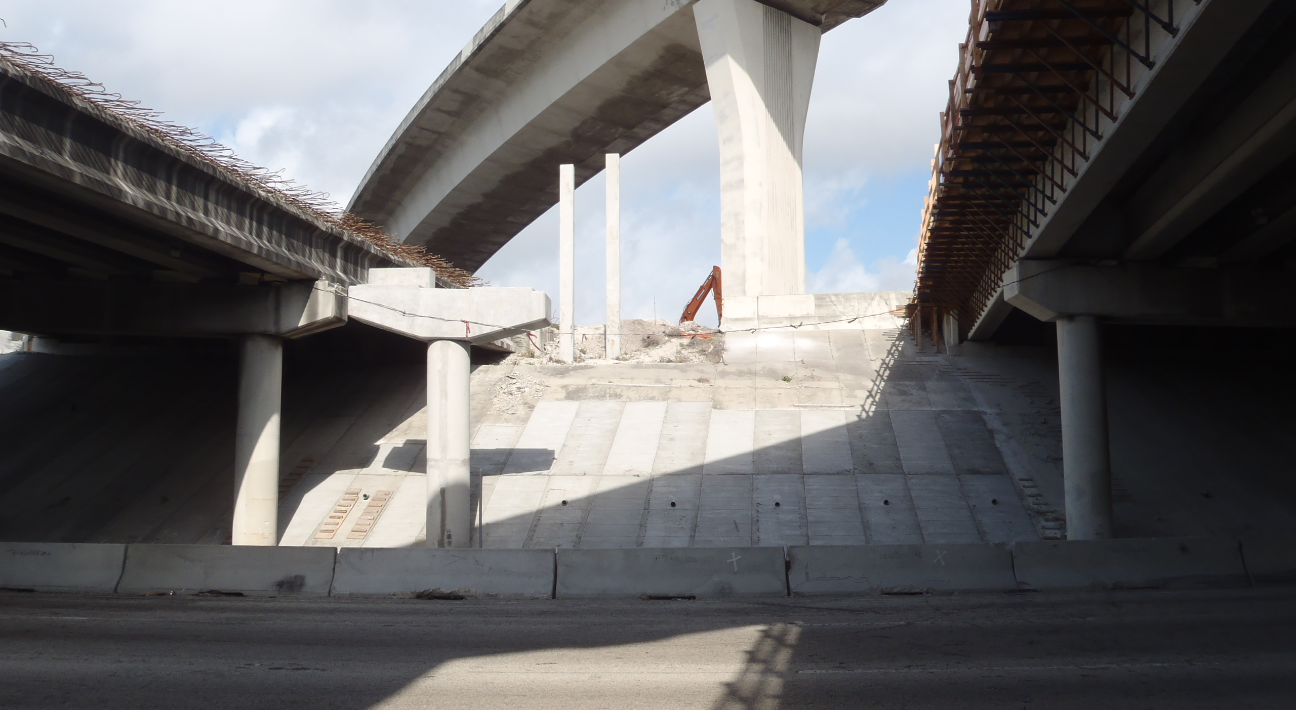
Low overhead conditions/conflicts with existing piles
End Bent 1 North (during construction)
Photo by Chris Burroughs (Amec Foster Wheeler)

Slide 45
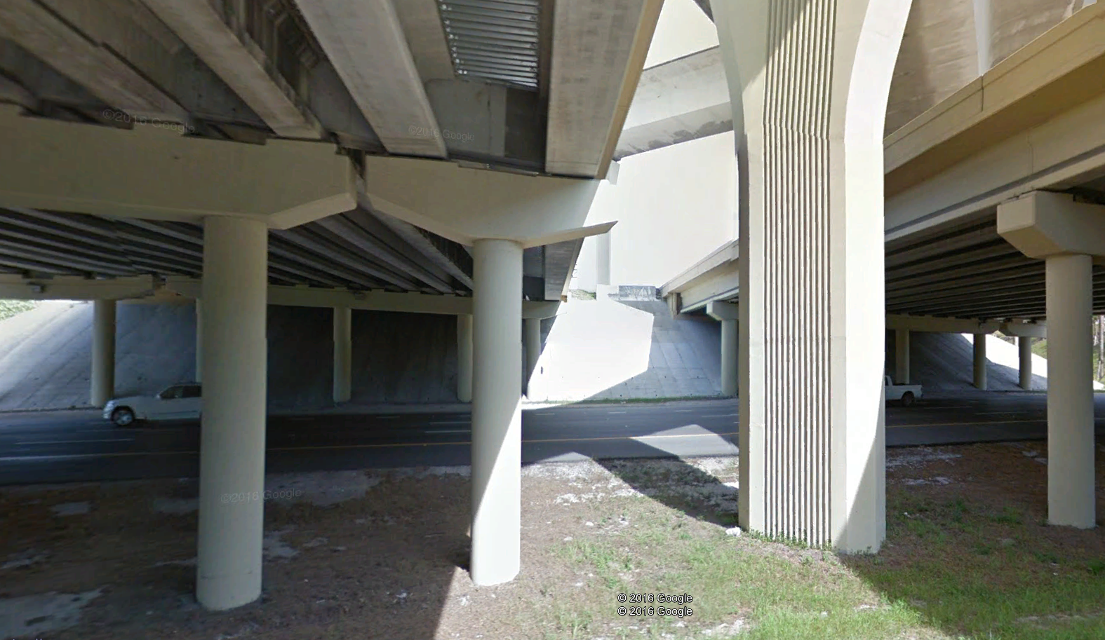
Low overhead conditions/conflicts with existing piles
Pier 3 North (post-construction condition shown)
Google Earth

Slide 46
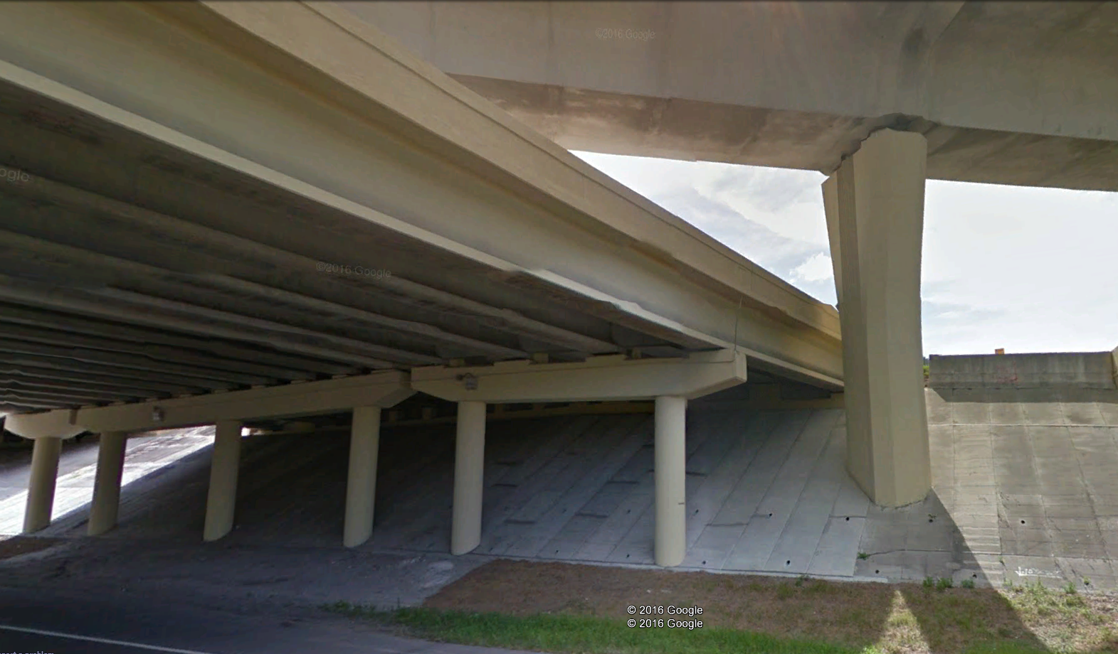
Low overhead conditions/conflicts with existing piles
Pier 4 South (post-construction condition shown)
Google Earth

Slide 47
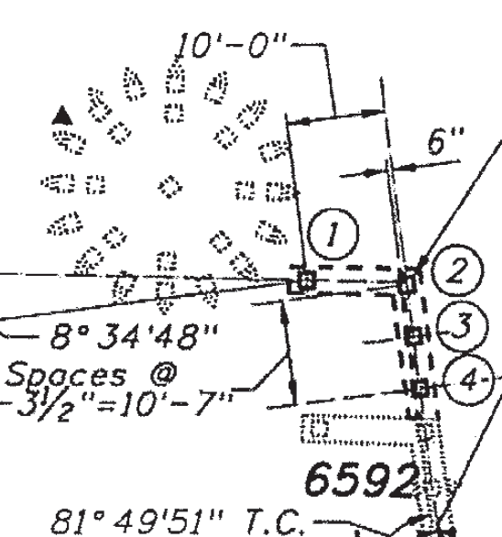
Conflicts with existing piles
End Bent 1 North
Reference: Foundation Layout, Bridge No. 860418, prepared by AECOM (6/17/2010)

Slide 48
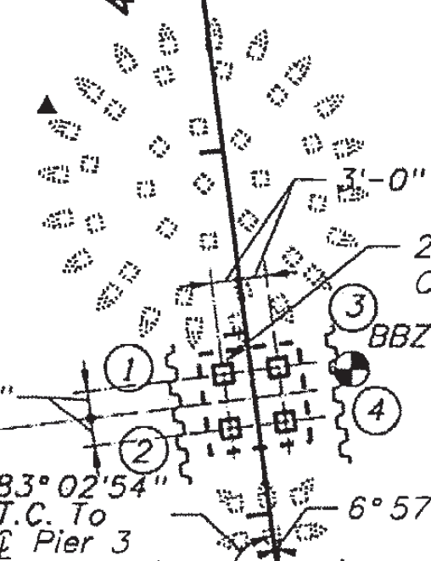
Conflicts with existing piles
Pier 3 North
Reference: Foundation Layout, Bridge No. 860418, prepared by AECOM (6/17/2010)

Slide 49
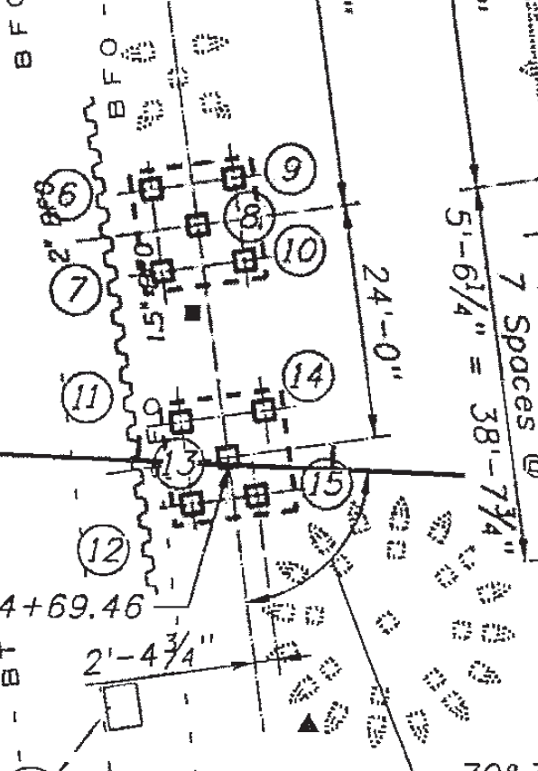
Conflicts with existing piles
Pier 4 South
Reference: Foundation Layout, Bridge No. 860418, prepared by AECOM (6/17/2010)

Slide 50
Foundation type selection
End Bent 1N, Piers 3N and 4S
Splices were planned for the PSC piles to accommodate the low overhead conditions
Subsequently decided to utilize 18” diameter, closed-ended steel pipe piles for these three piers

Slide 51
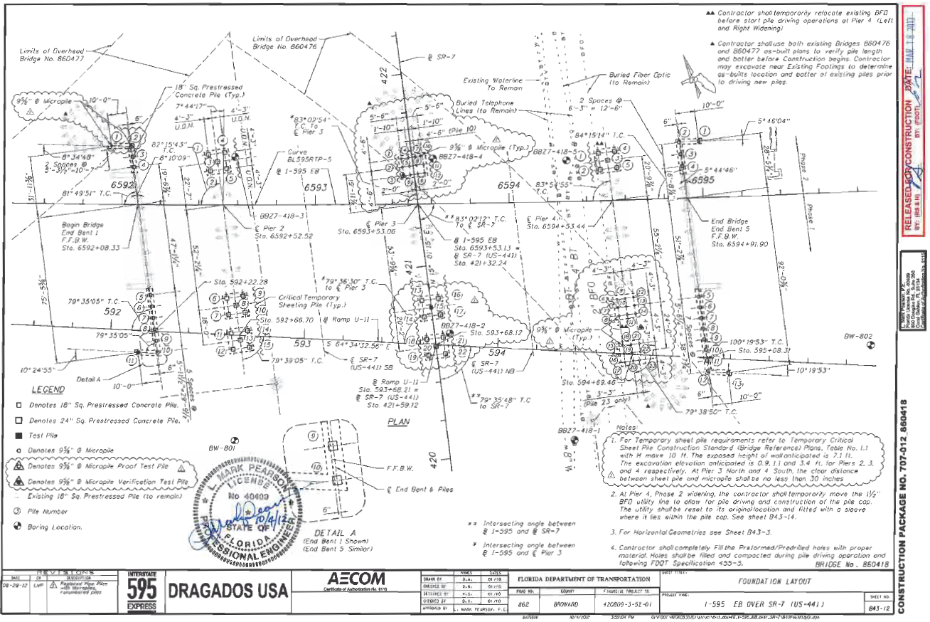
Foundation type selection
End Bent 1N, Piers 3N and 4S
Later revised design to use 9⅝-inch diameter micropiles at these locations

Slide 52
Micropile design loads
Bridge No. 860418
Bent/Pier No. | Factored Design Load per Pile, R_{r} (tons)
End Bent 1 North | 95
Pier 3 North | 121
Pier 4 South | 110
Factored lateral loads: 2 to 3 tons per micropile

Slide 53
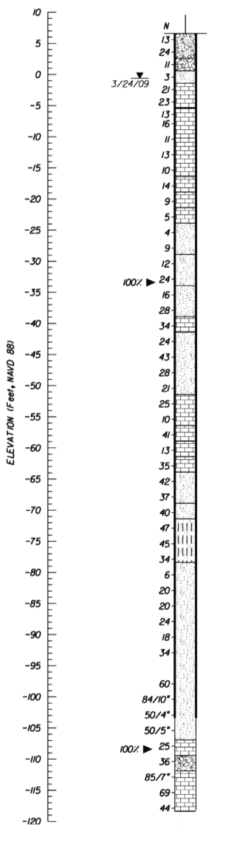
Subsurface conditions
Boring BBZ7-418-2
5’-10’ fill (limerock, sand)
Alternating layers of weakly cemented limestone and loose to dense sand (N=5 to 60 bpf, with occasional zones of N≥100 bpf)
Groundwater 5’-8’ bgs

Slide 54
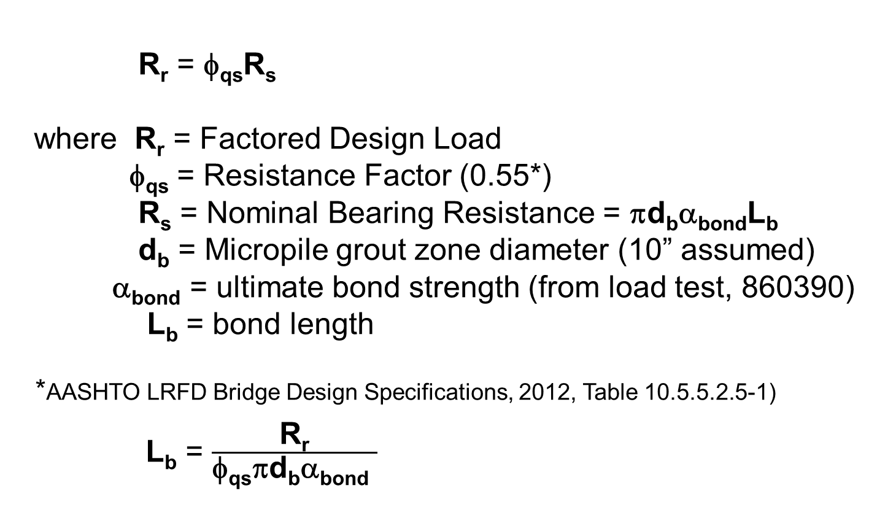
Micropile design
R_{r} = φ_{qs}R_{s}
where R_{r} = Factored Design Load
φ_{qs} = Resistance Factor (0.55*)
R_{s} = Nominal Bearing Resistance = πd_{b}α_{bond}L_{b}
d_{b} = Micropile grout zone diameter (10” assumed)
α_{bond} = ultimate bond strength (from load test, 860390)
L_{b} = bond length
*AASHTO LRFD Bridge Design Specifications, 2012, Table 10.5.5.2.5-1)
L_{b} = $\frac{\text{R}\text{r}}{\text{f}\text{qs}\text{p}\text{d}\text{b}\text{a}\text{bond} }$

Slide 55
Micropile design
Cased Zone Length: 18’9” (9” embedded in concrete cap)
Static compression load test performed earlier on a sacrificial test micropile located at Pier 4 of Bridge No. 860390
Back-calculated average grout-to-ground ultimate bond strength (α_{bond}) of that test micropile was1.73 tsf (24.0 psi)
Subsurface profile at Pier 4 of Bridge No. 860390 determined to be comparable to subsurface profiles of borings performed at Bridge No. 860418

Slide 56
Micropile design calculations
Used α_{bond} = 1.73 tsf (24 psi) from 860390 load test
Exception: Conservatively used α_{bond} = 0.72 tsf (10 psi) in upper 14’ below casing for Pier 4S due to presence of very loose to loose sand zone in boring
Reference:, Micropile Design & Construction, Table 5-3, FHWA NHI-05-039, December 2005

Slide 57
Micropile design calculations - results
Bent / Pier No. | R_{r} (tons) | R_{s} (tons) | L_{b} (ft) | Tip Elev. (ft)
1N | 95 | 173 | 39 | -52
3N | 121 | 220 | 49 | -70
4S | 110 | 200 | 49 | -65

Slide 58
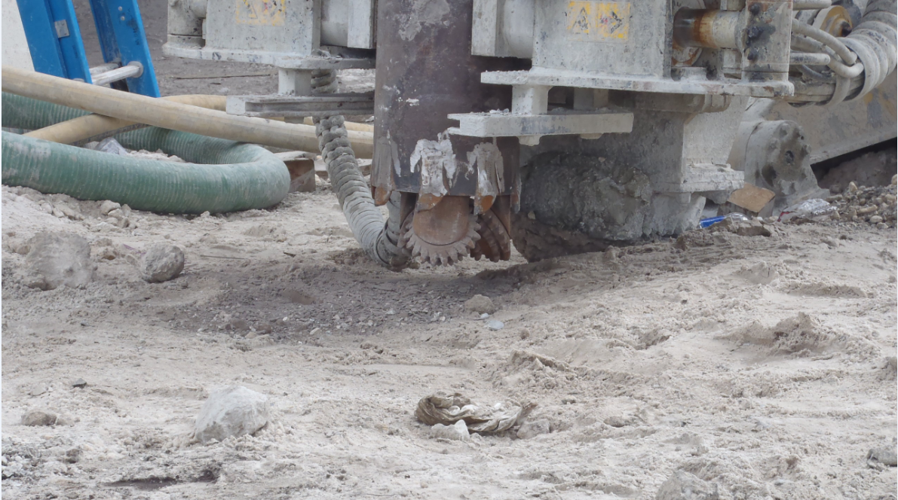

Micropile construction
Duplex drilling
Photo by Chris Burroughs (Amec Foster Wheeler)
Micropile contractor:

Slide 59
Load testing
Recommendations:
    One verification load test on a sacrificial micropile (Pier 4S)
    Two proof load tests on production micropiles (End Bent 1N and Pier 3N)

Slide 60
Verification load testing (general)
Verify installation methods capable of achieving the specified grout-to-ground bond capacity with a specified factor of safety
Conducted on non-production, “sacrificial” micropiles prior to construction of production piles
May or may not test micropile to failure
Rigorous multiple-cycle test with the test load progressively increased during each loading cycle until final specified maximum test load is reached

Slide 61
Proof load testing (general)
Conducted during construction on percentage of production micropiles
Intended to verify that contractor’s construction procedure has remained constant
Evaluates the ability of the micropile to safely carry the design load in service without excessive structural movement or long-term creep

Slide 62
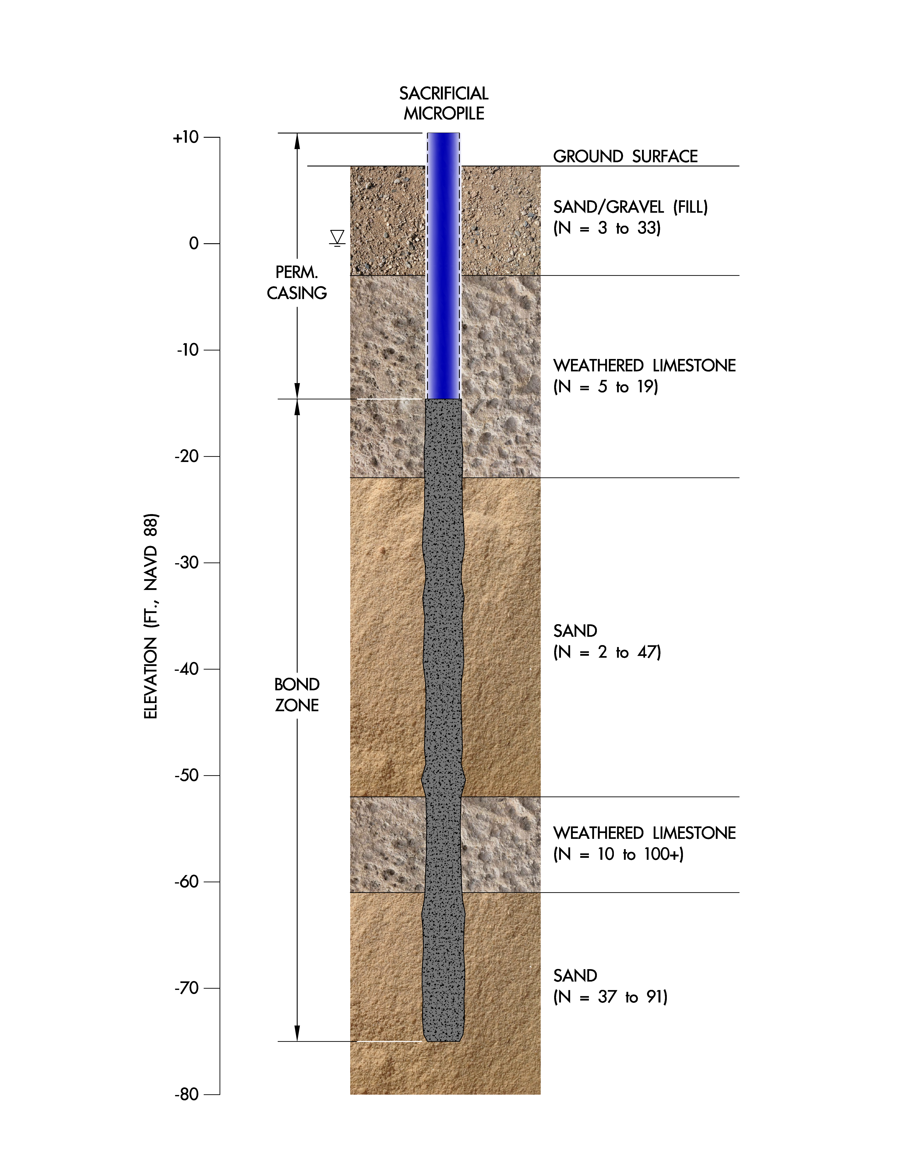
Verification load test pile at Pier 4S
L_{b} = 57’ (bond zone) calculated for verification test pile based on subsurface conditions at Pier 4S and the higher NBR from Pier 3N

Slide 63
Verification load test pile at Pier 4S
Moretrench installed verification test micropile, a sacrificial pile near Pier 4S
As-built L_{b} = 59.5’
Grouting procedure: Type C (primary grout placed under gravity head, then one phase of secondary “global” pressure grouting)

Slide 64
Verification load test pile installation
Photo by Chris Burroughs (AmecFW)

Slide 65
Verification load test pile installation
Photo by Chris Burroughs (AmecFW)

Slide 66
Verification load test pile installation
Photo by Chris Burroughs (Amec Foster Wheeler)

Slide 67
Verification load test pile installation
Photo by Chris Burroughs (AmecFW)

Slide 68
Verification load test pile installation
Photo by Chris Burroughs (AmecFW)

Slide 69
Verification load test pile installation
Photo by Chris Burroughs (AmecFW)

Slide 70
Verification load test pile installation
Photo by Chris Burroughs (AmecFW)

Slide 71
Verification load test pile installation
Photo by Chris Burroughs (AmecFW)

Slide 72
Verification load test pile installation
Photo by Chris Burroughs (AmecFW)

Slide 73
Verification load test pile installation
Photo by Chris Burroughs (AmecFW)

Slide 74
Verification load test pile installation
Photo by Chris Burroughs (AmecFW)

Slide 75
Verification load test at Pier 4S
Moretrench performed the verification load test
ASTM D1143, Standard Test Methods for Deep Foundations Under Static Axial Compressive Load (Quick Method)
Witnessed by Amec Foster Wheeler

Slide 76
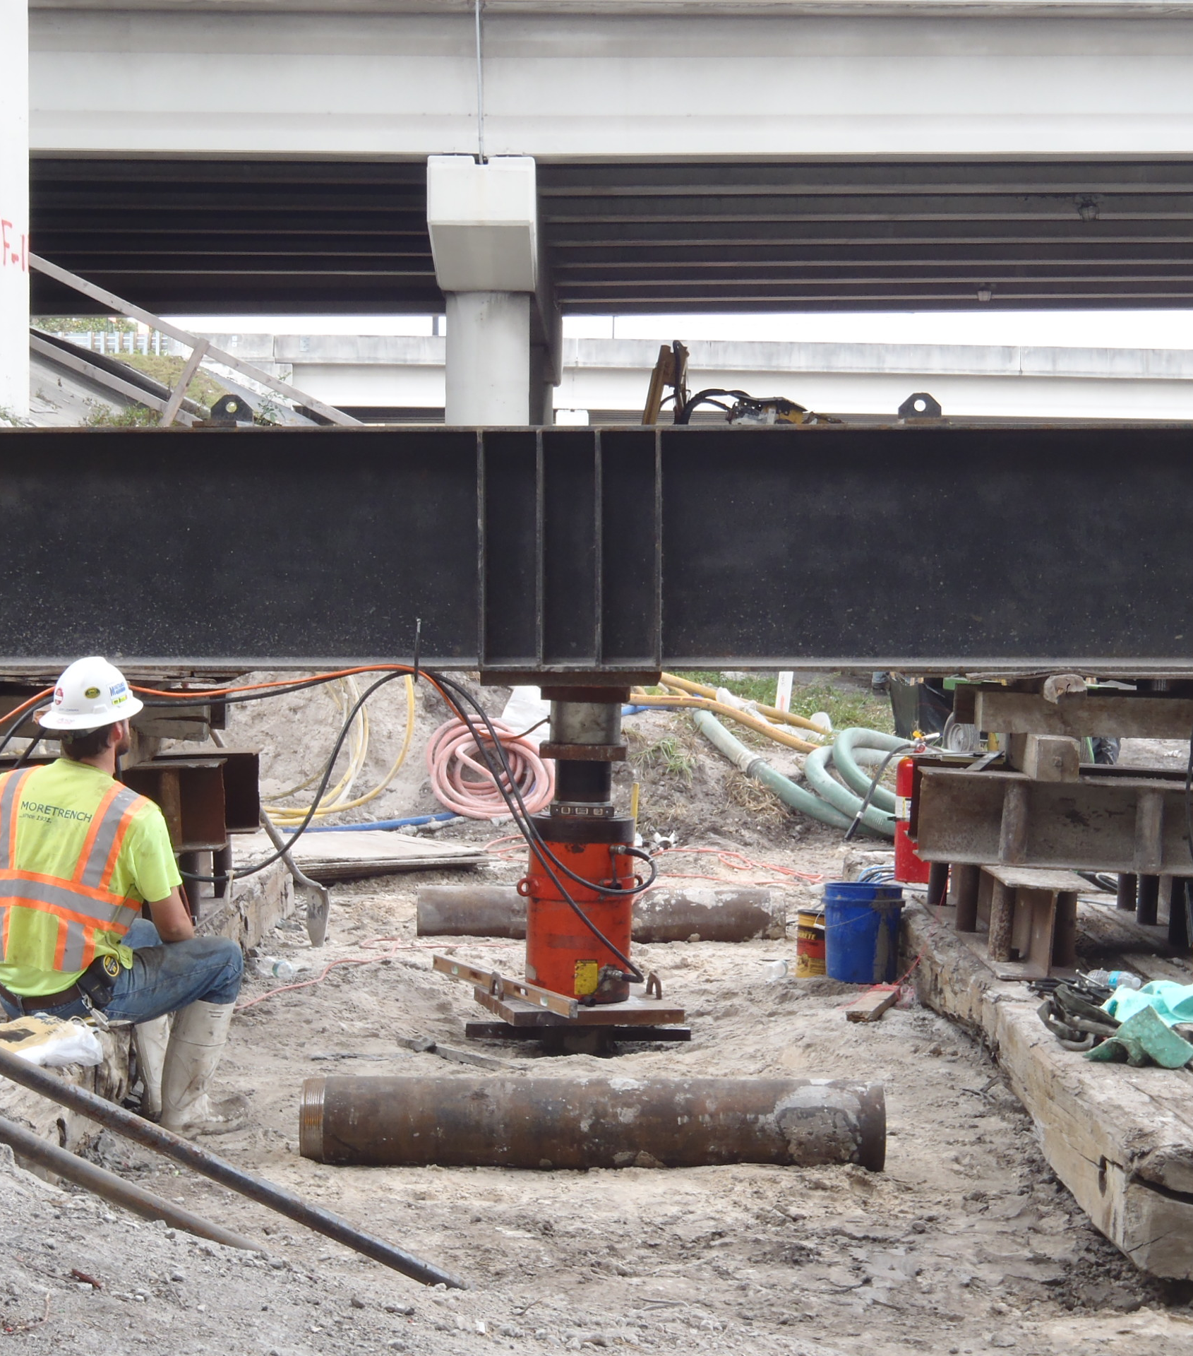
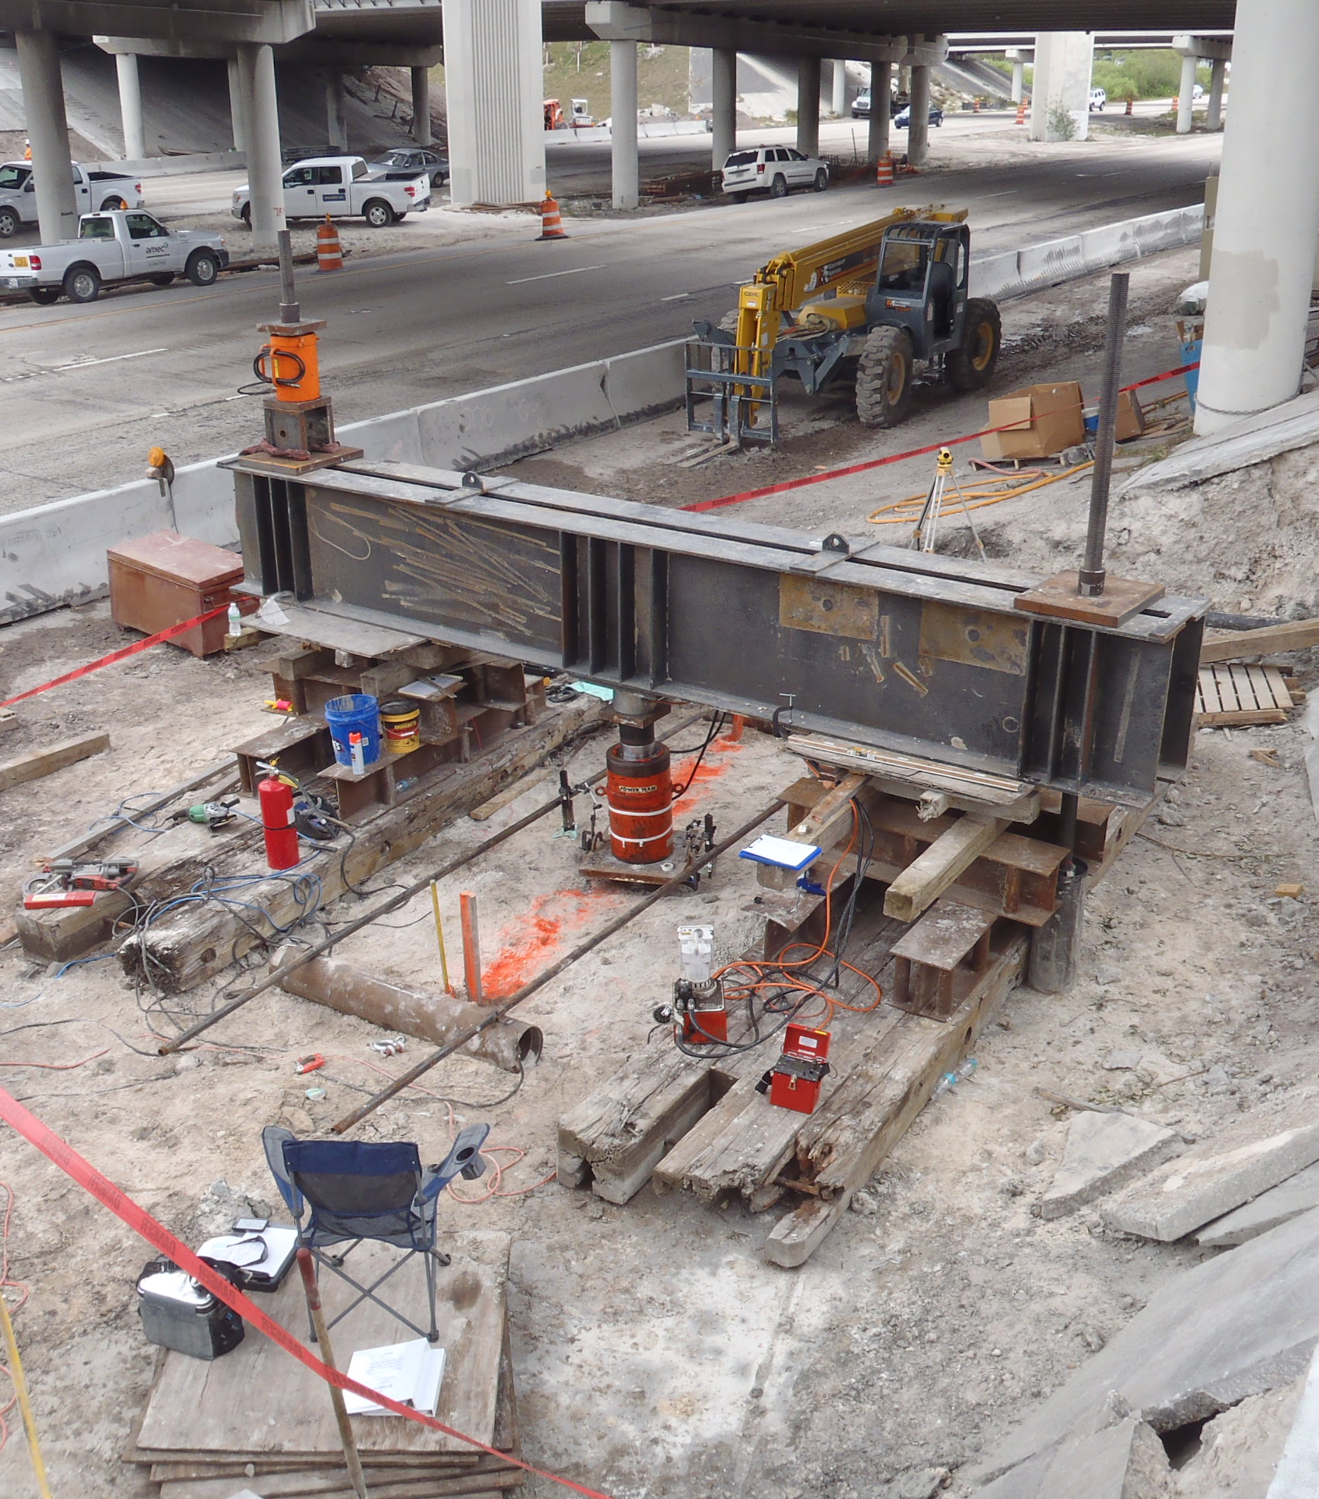
Verification load test at Pier 4S
Photo by Chris Burroughs (AmecFW)
Photo by Chris Burroughs (AmecFW)

Slide 77
Verification load test at Pier 4S
Per TSP, verification test pile loaded in compression to 2.0*FDL for Pier 3N, since that was the highest FDL (test load of 242 tons)
Continued loading to 280 tons in attempt to fail the pile

Slide 78
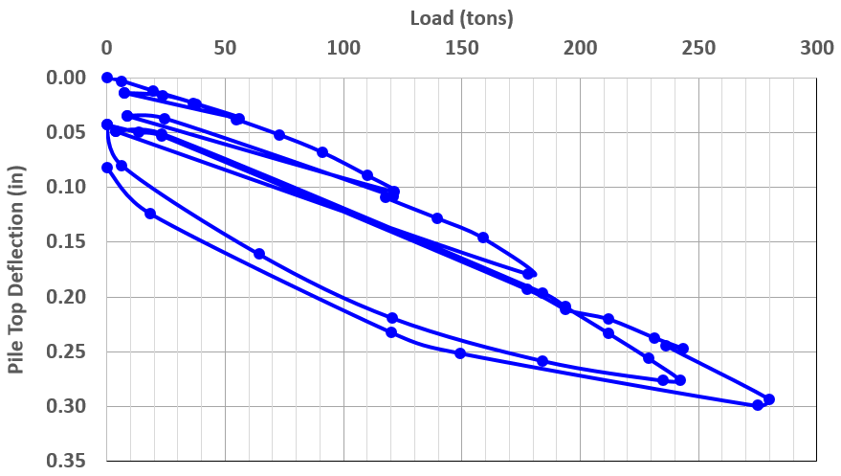
Verification load test at Pier 4S (five cycles)

Slide 79
Verification load test at Pier 4S
Maximum deflection: 0.3”
Back-calculated α_{bond} = 1.80 tsf (25 psi)
Neglects end-bearing
Confirmed α_{bond} = 1.73 tsf (24 psi) from earlier load test for Bridge No. 860390 used in design calculations for this bridge

Slide 80
Production piles
Revised L_{b} = 59.5’ to be consistent with the verification test pile (conservative)
Original micropile design required grout pressure of 50 psi
Verification test micropile installed with grout pressure of 70 psi
Grout pressure of 70 psi was therefore required for installation of production micropiles

Slide 81
Production micropiles installed by Moretrench
Bent/Pier No. | Total Quantity of Micropiles
End Bent 1N (Wingwall) | 1
Pier 3N | 12
Pier 4S | 18

Slide 82
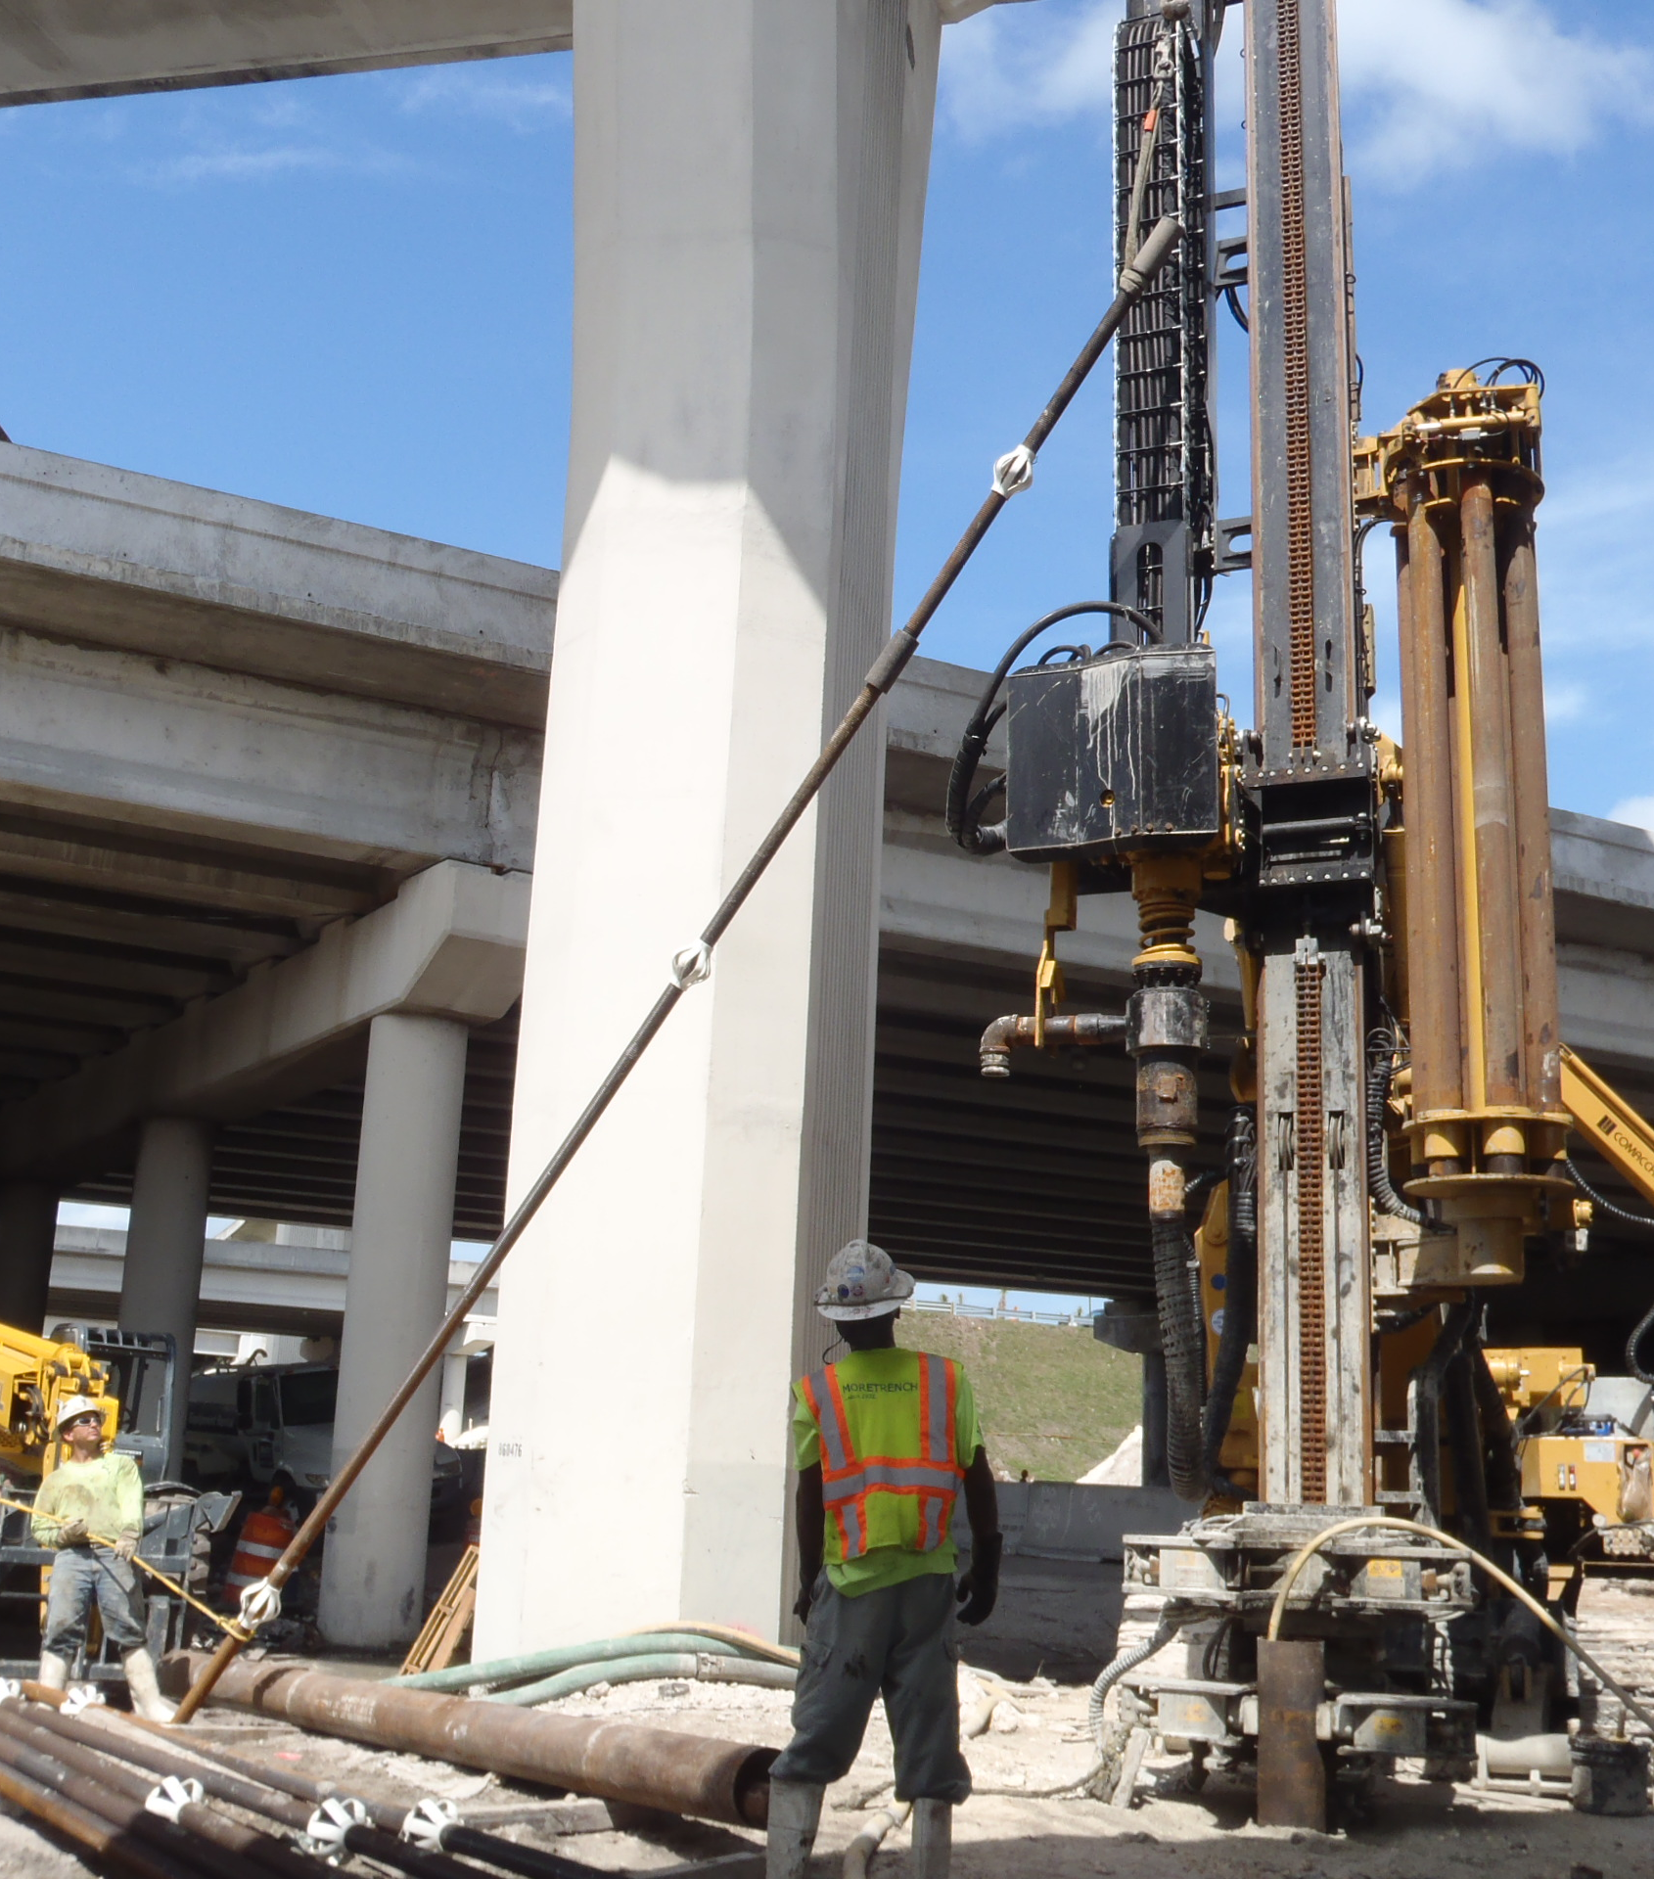
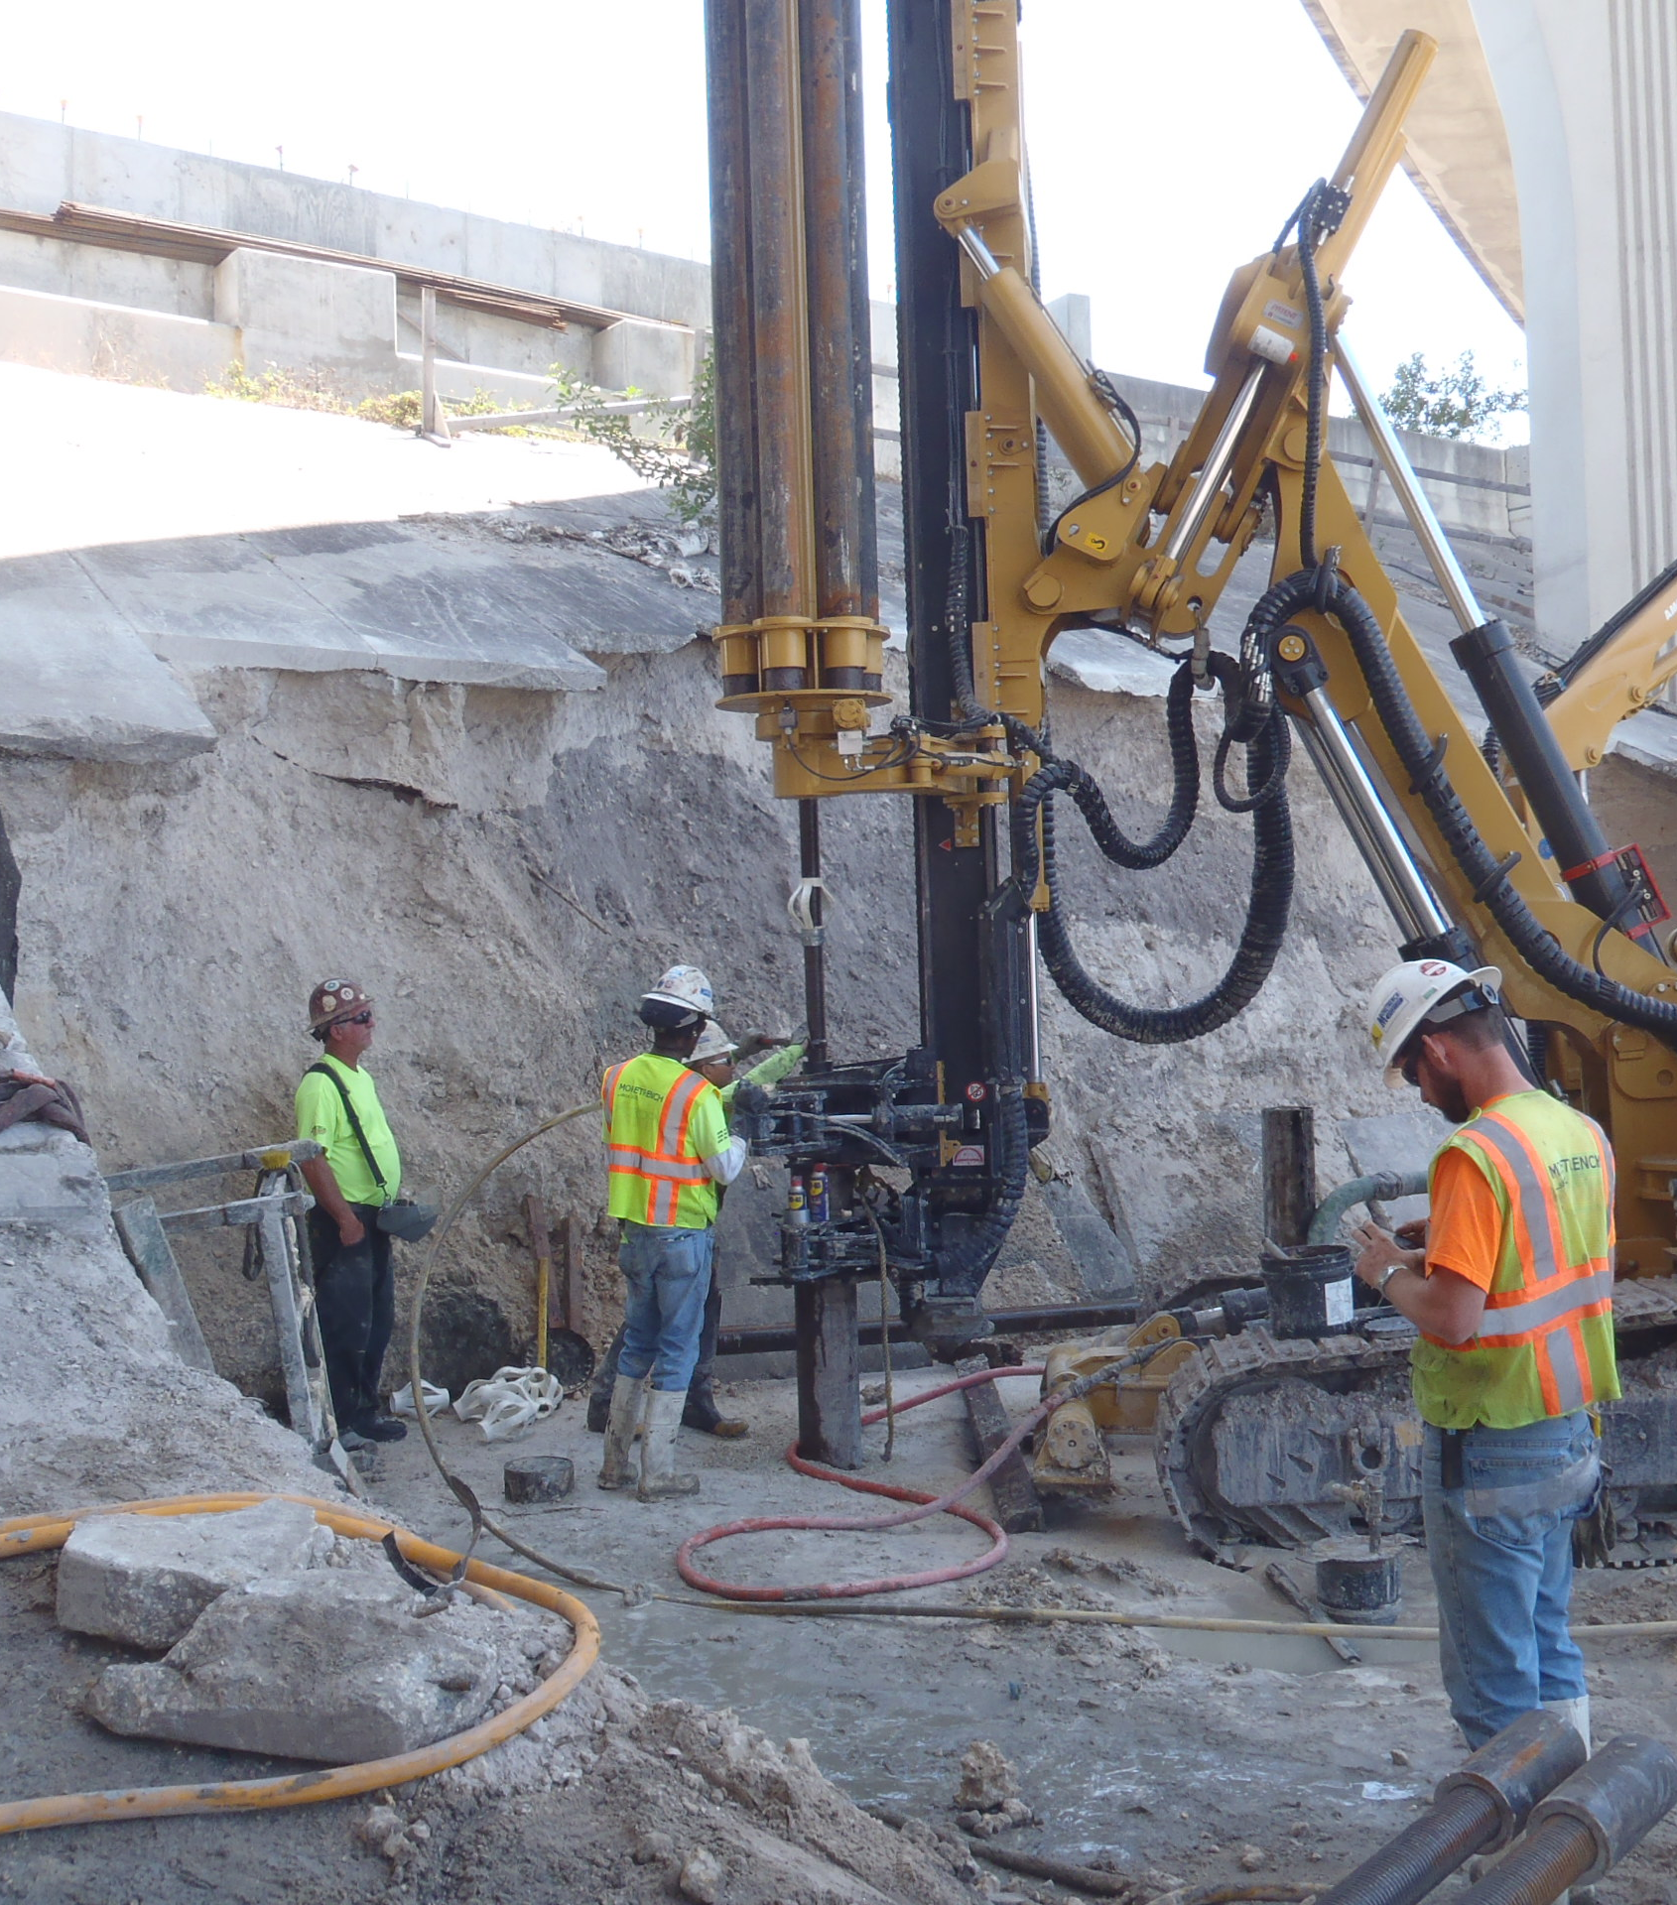
Production pile installation
Photo by Chris Burroughs (AmecFW)
Photo by Chris Burroughs (AmecFW)
Witnessed/logged by Amec Foster Wheeler

Slide 83
Proof tests
Proof tests performed on one production micropile at each of End Bent 1N and Pier 3N, as planned, to 1.0*FDL
Tests performed in tension so reaction piles not needed
ASTM D3689, Standard Test Methods for Deep Foundations Under Static Axial Tensile Load (Quick Method)

Slide 84
Low grout pressures at Pier 4S
Three piles at Pier 4S were installed with grout pressures of 50 to 65 psi
Additional proof test recommended to be performed on pile that had an installation grout pressure of 50 psi
Purpose: Demonstrate that all three of these micropiles are capable of resisting the factored design load of 110 tons for Pier 4S
Total of three proof load tests conducted for this bridge
Witnessed/logged by Amec Foster Wheeler

Slide 85
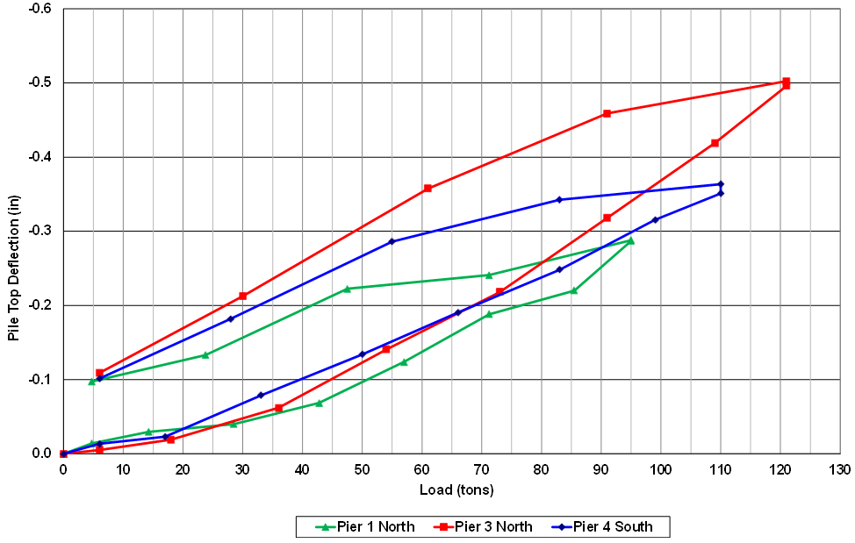
Proof load test results
(Max. deflections = 0.3”-0.5”)

Slide 86
Conclusion
All production piles were accepted because:
    Piles installed in general accordance with the verification test pile
    Proof load tests indicated tolerable movements under service loads

Slide 87
GeoPoem
The Mighty Micropile
By Mary C. Nodine
When you cannot use spread footings
‘Cause your bearing layer’s deep,
And the nice abutting neighbors
Ask that you kindly keep
Construction noises to a minimum
Or else a fine you’ll pay –
The Mighty Micropile
Spins in to save the day.
He doesn’t look imposing,
His diameter so small –
You wouldn’t think that he’d support
Much axial load at all.
But with a big steel bar and casing
And a socket into rock
Those nine- or twelve-inch piles
Take 200 tons a pop.
Apart from their capacity
To support such heavy weights
There are other superpowers
That make the micropile great.
Perhaps you need foundations
In a space with low headroom...
You simply need to find a drill rig
With the right size boom,
And - Voila! Yes, you may need to drill them
Five feet at a time...
But in those situations
The micropile shines.
Installed with roller bits as tough
As nails - or even more –
They’ll drill through almost any big
Obstruction that’s in store.
Nimble, strong and versatile,
The Mighty Micropile
Can even underpin old buildings
As they come back into style.
But he has limits – for example,
Skyscrapers aren’t his craft.
So he calls upon his sidekick:
The Daredevil Drilled Shaft.
Mary C. Nodine, PE, M.ASCE, is a geotechnical poet and a project engineer with GEI Consultants, Inc. in Woburn, MA. She can be reached at mnodine@geiconsultants.com.
(Published in the July/August edition of GEOSTRATA Magazine. Used with written permission from the author.)

Slide 88
Q&A

Slide 89
Thank you!
Michael B. Woodward, P.E.
mike.b.woodward@amecfw.com
(904) 391-3715

